Slide 1
Revelation 6 - 8:1
Scene 2: The Sufferings of the Church
OIF
Paul J. Bucknell

Slide 2

The 8 Scenes of Revelation
# | Scenes | 7 Settings | Opening scene | Summary | Special focus | Key thought
1 | 1:19-3:22 Church in the World | Seven letters dictated | John turns to see who is speaking | Christ speaks to the 7 churches | 7 commonalities with pointed differences. | Cure for lukewarmness?Readmit the excluded Christ! p.58
2 | 4:1-8:1 Suffering for Church | Seven seals opened | A door in heaven opens | God’s power (4-5); woes on earth (6-7) | Seals will not be opened until later–Preparatory/warning | Christ’s explanation of history makes it full of meaning. p.69
3 | 8:2-11:18 Warnings for World
4 | 11:19-15:4 Drama of History
5 | 15:5-16:21 Punishment for World
6 | 17:1-19:10 Babylon the Whore
7 | 19:11-21:8 Drama Behind History
8 | 21:9-22:19 Jerusalem the Bride
What characterizes the Great Tribulation?
What does God reveal about the 144,000?
Why is there so much killing of believers through the centuries right up to now?

Slide 3


Scene 2: The Sufferings of the Church
Chapters 4-5 (prior lesson)
“After these things I looked, and behold, a door standing open in heaven, and the first voice which I had heard, like the sound of a trumpet speaking with me, said, ‘Come up here, and I will show you what must take place after these things’” (Rev 4:1).
Awesome heavenly throne of God
God’s grand redemptive plan sealed up
Only Jesus, the Lamb and Lion, can open 7 seals
Great praise and glory lifted to God
Chapters 6-7,8:1 (this lesson)
“And I saw when the Lamb broke one of the seven seals, and I heard one of the four living creatures saying as with a voice of thunder, ‘Come’” (Rev 6:1).
The Lamb broke the seals and unveiled the view of God’s plan that would soon be put into operation.

Slide 4
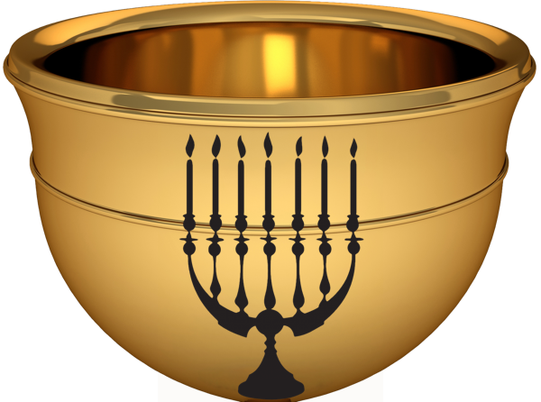
Revelation Chapters 6-8:1
Scene #2 (4-8:1)
Study sheet: Discover the uniqueness of each seal!
Seal | Reference | Saw or Heard | Authority/Observation | Other/Interpretation
1 | Rev 6:1-2 | “Come”; saw white horse, conqueror and bow | He went out conquering to conquer | Not white horse of 19:11. This one like judging angel.
2
3
4
5
6
7

Slide 5
Revelation Chapters 6-8:1
Scene #2 (4-8:1)
6:1 Now I watched when the Lamb opened one of the seven seals, and I heard one of the four living creatures say with a voice like thunder, “Come!” 2 And I looked, and behold, a white horse! And its rider had a bow, and a crown was given to him, and he came out conquering, and to conquer.
3 When he opened the second seal, I heard the second living creature say, “Come!” 4 And out came another horse, bright red. Its rider was permitted to take peace from the earth, so that people should slay one another, and he was given a great sword.
5 When he opened the third seal, I heard the third living creature say, “Come!” And I looked, and behold, a black horse! And its rider had a pair of scales in his hand. 6 And I heard what seemed to be a voice in the midst of the four living creatures, saying, “A quart of wheat for a denarius, and three quarts of barley for a denarius, and do not harm the oil and wine!”
7 When he opened the fourth seal, I heard the voice of the fourth living creature say, “Come!” 8 And I looked, and behold, a pale horse! And its rider's name was Death, and Hades followed him. And they were given authority over a fourth of the earth, to kill with sword and with famine and with pestilence and by wild beasts of the earth.
9 When he opened the fifth seal, I saw under the altar the souls of those who had been slain for the word of God and for the witness they had borne. 10 They cried out with a loud voice, “O Sovereign Lord, holy and true, how long before you will judge and avenge our blood on those who dwell on the earth?” 11 Then they were each given a white robe and told to rest a little longer, until the number of their fellow servants and their brothers should be complete, who were to be killed as they themselves had been.
12 When he opened the sixth seal, I looked, and behold, there was a great earthquake, and the sun became black as sackcloth, the full moon became like blood, 13 and the stars of the sky fell to the earth as the fig tree sheds its winter fruit when shaken by a gale….
8:1 When the Lamb opened the seventh seal, there was silence in heaven for about half an hour.

Slide 6
A PreTribulation Rapture?
Insinuation
Counter Argument
3:10 “Because you have kept the word of My perseverance, I also will keep you from the hour of testing, that hour which is about to come upon the whole world, to test those who dwell upon the earth.”
But it seems obvious that this promise was written to the church at Philadelphia who alone persevered through hardships.
This “keep you from the hour of testing” is a promise to keep the church from tribulation.
Invitation
4:1 “After these things I looked, and behold, a door standing open in heaven, and the first voice which I had heard, like the sound of a trumpet speaking with me, said, “Come up here, and I will show you what must take place after these things.’”
But this was a personal invitation to John (“I”), rather than to the whole church to be raptured.
The invitation refers to the rapture of the church to heaven.
Identification
4:4 “And around the throne were twenty-four thrones; and upon the thrones I saw twenty-four elders sitting, clothed in white garments, and golden crowns on their heads.”
But a lack of clear identification of the 24 elders does not make it the basis for unclear teaching!
The 24 elders refers to the raptured church.

Slide 7
The Difficulty of Timing
raptured
To keep us from the tribulation
End of Rev
tribulation
Return of Christ
God promised
Rev 3-4
Rev 5 onwards
Post-trib Experience
Pre-trib Rapture
End of Rev
tribulation
Return of Christ
God promised
stay on earth
To keep us during the tribulation

Slide 8
Signs of the End
3 And as He was sitting on the Mount of Olives, the disciples came to Him privately, saying, “Tell us, when will these things be, and what will be the sign of Your coming, and of the end of the age?”
4 And Jesus answered and said to them, “See to it that no one misleads you. 5 “For many will come in My name, saying, ‘I am the Christ,’ and will mislead many.
6 “And you will be hearing of wars and rumors of wars…but that is not yet the end. 7 “For nation will rise against nation, and kingdom against kingdom, and in various places there will be famines and earthquakes.
8 “But all these things are merely the beginning of birth pangs. 9 “Then they will deliver you to tribulation, and will kill you, and you will be hated by all nations on account of My name….
29 “But immediately after the tribulation of those days THE SUN WILL BE DARKENED, AND THE MOON WILL NOT GIVE ITS LIGHT, AND THE STARS WILL FALL from the sky, and the powers of the heavens will be shaken, 30 and then the sign of the Son of Man will appear in the sky, and then all the tribes of the earth will mourn, and they will see the SON OF MAN COMING ON THE CLOUDS OF THE SKY with power and great glory. 31 “And He will send forth His angels with A GREAT TRUMPET and THEY WILL GATHER TOGETHER His elect from the four winds…
Jesus – Rev 6-7
“seven seals”
“went out conquering” (6:2)
“great sword” (6:4)
Signs of the End
“quart of wheat for a denarius” (6:6)
War
Famine
Random killing
“Death; and Hades” (6:8)
Jesus – Matthew 24
Jesus – Revelation 6-7
False Christs
Martyrdom
“famine and with pestilence” (6:8)
Pestilence
Death
Ecological disasters
Persecution
“been slain because of the word of God” (6:9)
“great earthquake; moon became like blood” (6:12)
“sealed the bond-servants of our God” (7:3)
“harm the earth and the sea” (7:2)

Slide 9
Revelation Chapters 6-8:1
Scene #2 (4-8:1)
Study sheet: Discover the uniqueness of each seal!
Seal | Reference | Saw or Heard | Authority/Observation | Other/Interpretation
1 | Rev 6:1-2 | “Come”; saw white horse, conqueror and bow | He went out conquering to conquer | Not white horse of 19:11. This one like judging angel.
2 | Rev 6:3-4 | “Come”; saw red horse | Granted to take peace from earth; men kill each other;take peace from earth | Great sword given to him - meaning many would be killed
3 | Rev 6:5-6 | “Come”; saw black horse with pair of scales | Wheat and barley (grains) become very expensive. Cooking oil and wine not affected. | High costs of food indicate famine of some sort.
4 | Rev 6:7-8 | “Come”; saw ashen horse with name on it,” Death” | Hades followed the horse. Authority over 1/4 earth to kill by sword, famine, insects, beasts.
5 | Rev 6:9-11 | Saw dead martyrs cry out under the altar | They cried out, “How long Lord till avenge us!” Judgment requested. | Slain because of the Word of God and testimony = martyr. They got white robe and to wait.
6 | Rev 6:12-7:17 | Saw great earthquake and sun darkened; moon like blood | Sky split; every mountain and island moved. Sealed 144,000.Praise scene. Comfort. | People were all totally afraid and hiding from God’s wrath.
7 | Rev 8:1 | Silence; heard nothing | Only one verse. The scroll opens as last seal broken and introduces the 7 trumpet warnings and bowls. | Silence for ½ hour

Slide 10
Topic #1: 144,000 Sealed (Rev 7:1-8)
7:1 After this I saw four angels standing at the four corners of the earth, holding back the four winds of the earth, so that no wind should blow on the earth or on the sea or on any tree.
2 And I saw another angel ascending from the rising of the sun, having the seal of the living God; and he cried out with a loud voice to the four angels to whom it was granted to harm the earth and the sea, 3 saying, “Do not harm the earth or the sea or the trees, until we have sealed the bond-servants of our God on their foreheads.” 4 And I heard the number of those who were sealed, one hundred and forty-four thousand sealed from every tribe of the sons of Israel:
Four: angels, corners, winds
Sealed refers to protected and secured by salvation of cross and presence of Holy Spirit (Eph 1:13): “In Him, you also, after listening to the message of truth, the gospel of your salvation--having also believed, you were sealed in Him with the Holy Spirit of promise.”
The “sealed” (Ez 9:4) 144,000 is assumed to be the same as the great multitude from all nations (7:9-12) reminding us of the brilliant throne room in chapters 4-5 (ch. 5:9-14). These saints are protected: “And unless those days had been cut short, no life would have been saved; but for the sake of the elect those days shall be cut short” (Mat 24:22).

Slide 11
Topic #1: 144,000 Sealed (Rev 7:1-8)
7:4 And I heard the number of those who were sealed, one hundred and forty-four thousand sealed from every tribe of the sons of Israel:
God’s People =144,000 = 12 tribes x 12,000
Judah – 12,000
Reuben – 12,000
Gad – 12,000
Asher – 12,000
Naphtali – 12,000
Manasseh – 12,000
Simeon – 12,000
Levi – 12,000
Issachar – 12,000
Zebulun – 12,000
Joseph – 12,000
Benjamin – 12,000
Jacob’s 12 sons=12 tribes
Dan is not mentioned
“One hundred and forty-four thousand sealed”: Some think only describes the Israelites but better understood as all of God’s people–children of Jacob–the true Israel (Rev: 21:9-14; Gal 6:16; Rom 2:29; Ja 1:1).
“Twelve thousand were sealed, from” each of 12 tribes. His point is inclusivity of all of God’s chosen people.
Judah is listed first (though 4th) because others lost ‘oldest’s’ extra portion.
Manasseh, Joseph’s son is added (really grandson from Joseph who got double portion).
Dan (one tribe) is not mentioned probably due to their flagrant idolatry (Jud 18:30).

Slide 12
The Difficulty of Timing
church raptured
To keep us from the tribulation
tribulation
God promised
Rev 5 onwards
144,000
Jews
End of Rev
tribulation
Return of Christ
144,000
God promised
all saints alive
The seals keep us during the tribulation

Slide 13
Topic #2: The Martyr’s Sandwich (Rev 7:9-17)
The Martyrs’ Sandwich
9 After these things I looked, and behold, a great multitude, which no one could count, from every nation and all tribes and peoples and tongues, standing before the throne and before the Lamb, clothed in white robes, and palm branches were in their hands; 10 and they cry out with a loud voice, saying, “Salvation to our God who sits on the throne, and to the Lamb.” 11 And all the angels were standing around the throne and around the elders and the four living creatures; and they fell on their faces before the throne and worshiped God, 12 saying, “Amen, blessing and glory and wisdom and thanksgiving and honor and power and might, be to our God forever and ever. Amen.”
The Martyrs’ Sandwich
Praise scene (7:9-12)
Martyrs’ suffering (7:13-14)
13 And one of the elders answered, saying to me, “These who are clothed in the white robes, who are they, and from where have they come?” 14 And I said to him, “My lord, you know.” And he said to me, “These are the ones who come out of the great tribulation, and they have washed their robes and made them white in the blood of the Lamb.
Comfort scene (7:15-17)
15 “For this reason, they are before the throne of God; and they serve Him day and night in His temple; and He who sits on the throne shall spread His tabernacle over them. 16 “They shall hunger no more, neither thirst anymore; neither shall the sun beat down on them, nor any heat; 17 for the Lamb in the center of the throne shall be their shepherd, and shall guide them to springs of the water of life; and God shall wipe every tear from their eyes.”

Slide 14
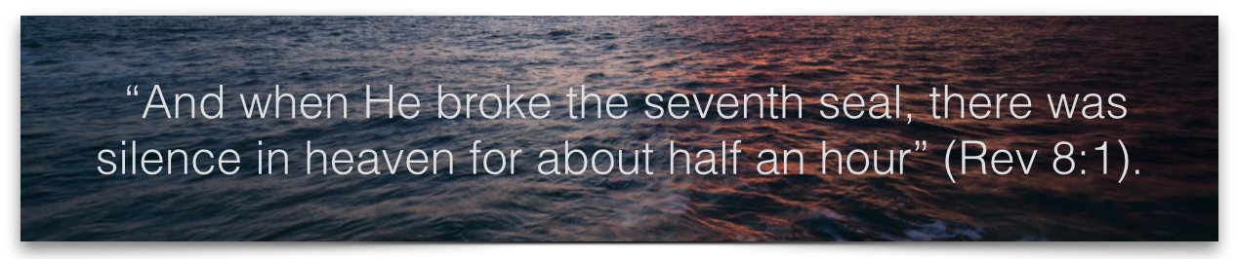
The End and Beginning
“Come, my people, enter into your rooms And close your doors behind you; Hide for a little while Until indignation runs its course. For behold, the LORD is about to come out from His place To punish the inhabitants of the earth for their iniquity; And the earth will reveal her bloodshed And will no longer cover her slain.” Isaiah 26:20-21 NASB
Scene 3: Trumpet Warnings for the World
Summary
There is no substantive reference of any pre-tribulation rapture in Revelation.
God’s people are given special insight into from these scenes to prepare them to persevere through the tribulations that lie ahead. It will be worth it!
The references to being sealed bring great encouragement to the saints as God guards our souls even in the most difficult situations.
The 7 seals give an early clue of what will happen during the tribulation both from an earthly and heavenly perspective. Since the seals reveal what is sure to come, they serve as a prophecy and a warning.

Slide 15
Study Questions
Discussion Questions
Who broke the seals? What is significant about that?
From this passage what would you think the reason God allows martyrdom of His people?
Do you think the silence in heaven after the 7th seal was broken was strange (compare ch. 4-5). What might be the significance?

Slide 16
Revelation 6 - 8:1
Scene 2: The Sufferings of the Church
OIF
Paul J. Bucknell

