Slide 1
Victory in Defeat
Mark 16:1-20
Calvin Chiang

Slide 2
A) The Resurrection (Mark 16:1-8)
When the Sabbath was over, Mary Magdalene, and Mary the mother of James, and Salome, bought spices, so that they might come and anoint Him. 2 Very early on the first day of the week, they came to the tomb when the sun had risen. 3 They were saying to one another, “Who will roll away the stone for us from the entrance of the tomb?” 4 Looking up, they saw that the stone had been rolled away, although it was extremely large. 5 Entering the tomb, they saw a young man sitting at the right, wearing a white robe; and they were amazed. 6 And he said to them, “Do not be amazed; you are looking for Jesus the Nazarene, who has been crucified. He has risen; He is not here; behold, here is the place where they laid Him. 7 But go, tell His disciples and Peter, ‘He is going ahead of you to Galilee; there you will see Him, just as He told you.’” 8 They went out and fled from the tomb, for trembling and astonishment had gripped them; and they said nothing to anyone, for they were afraid.

Slide 3
Jesus’ resurrection, the central key and foundation of what Christianity is built upon. It’s either one of the worst hoaxes or the most remarkable event in history.
What We Know: Jesus of Nazareth, a Jewish prophet who claimed to be the Christ prophesied in the Jewish scriptures, was arrested, judged a political criminal and was crucified. Three days after His death and burial, some women who went to His tomb found that His body was gone. In subsequent weeks, His disciples claimed that God has raised Him from the dead and that He appeared to them various times before ascending to heaven.
After the death of Jesus, His body was wrapped in linen cloth and the body was placed in a solid rock tomb, and an extremely large stone (about 2 tons) was rolled by means of levers against the tomb entrance. Roman guards (Matt 27:65-66) was then stationed to guard the entrance of the tomb with his life.
Background Info
Notes:
*Much like the question that we asked in an earlier lesson: The trilemma question: Jesus is either a liar, lunatic, or Lord?
*Without the resurrection, Christianity falls apart and no longer valid.
16 Roman guards tasked with the responsibility of guarding the tomb with their life.

Slide 4
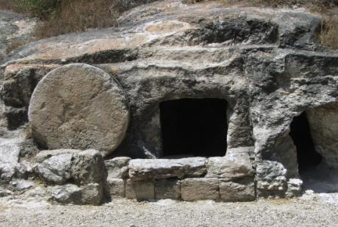
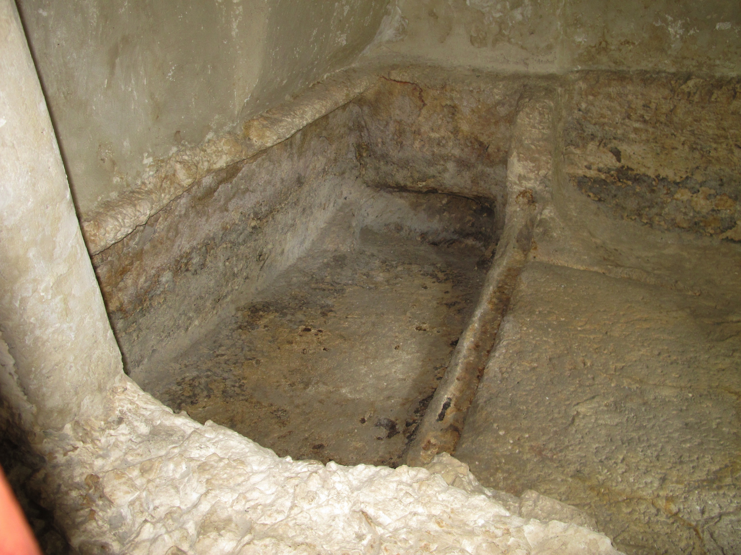
There are other examples from the Bible of people being resuscitated such as Lazarus (John 11:38-44) and the widow’s son in the days of Elijah (1Kings 17:17-24). They were raised from the dead to eventually die again. Jesus’ is different in that both His body and spirit was resurrected. It speaks to His deity. Jesus is the first and only one who claimed to have resurrected from the dead.

Slide 5
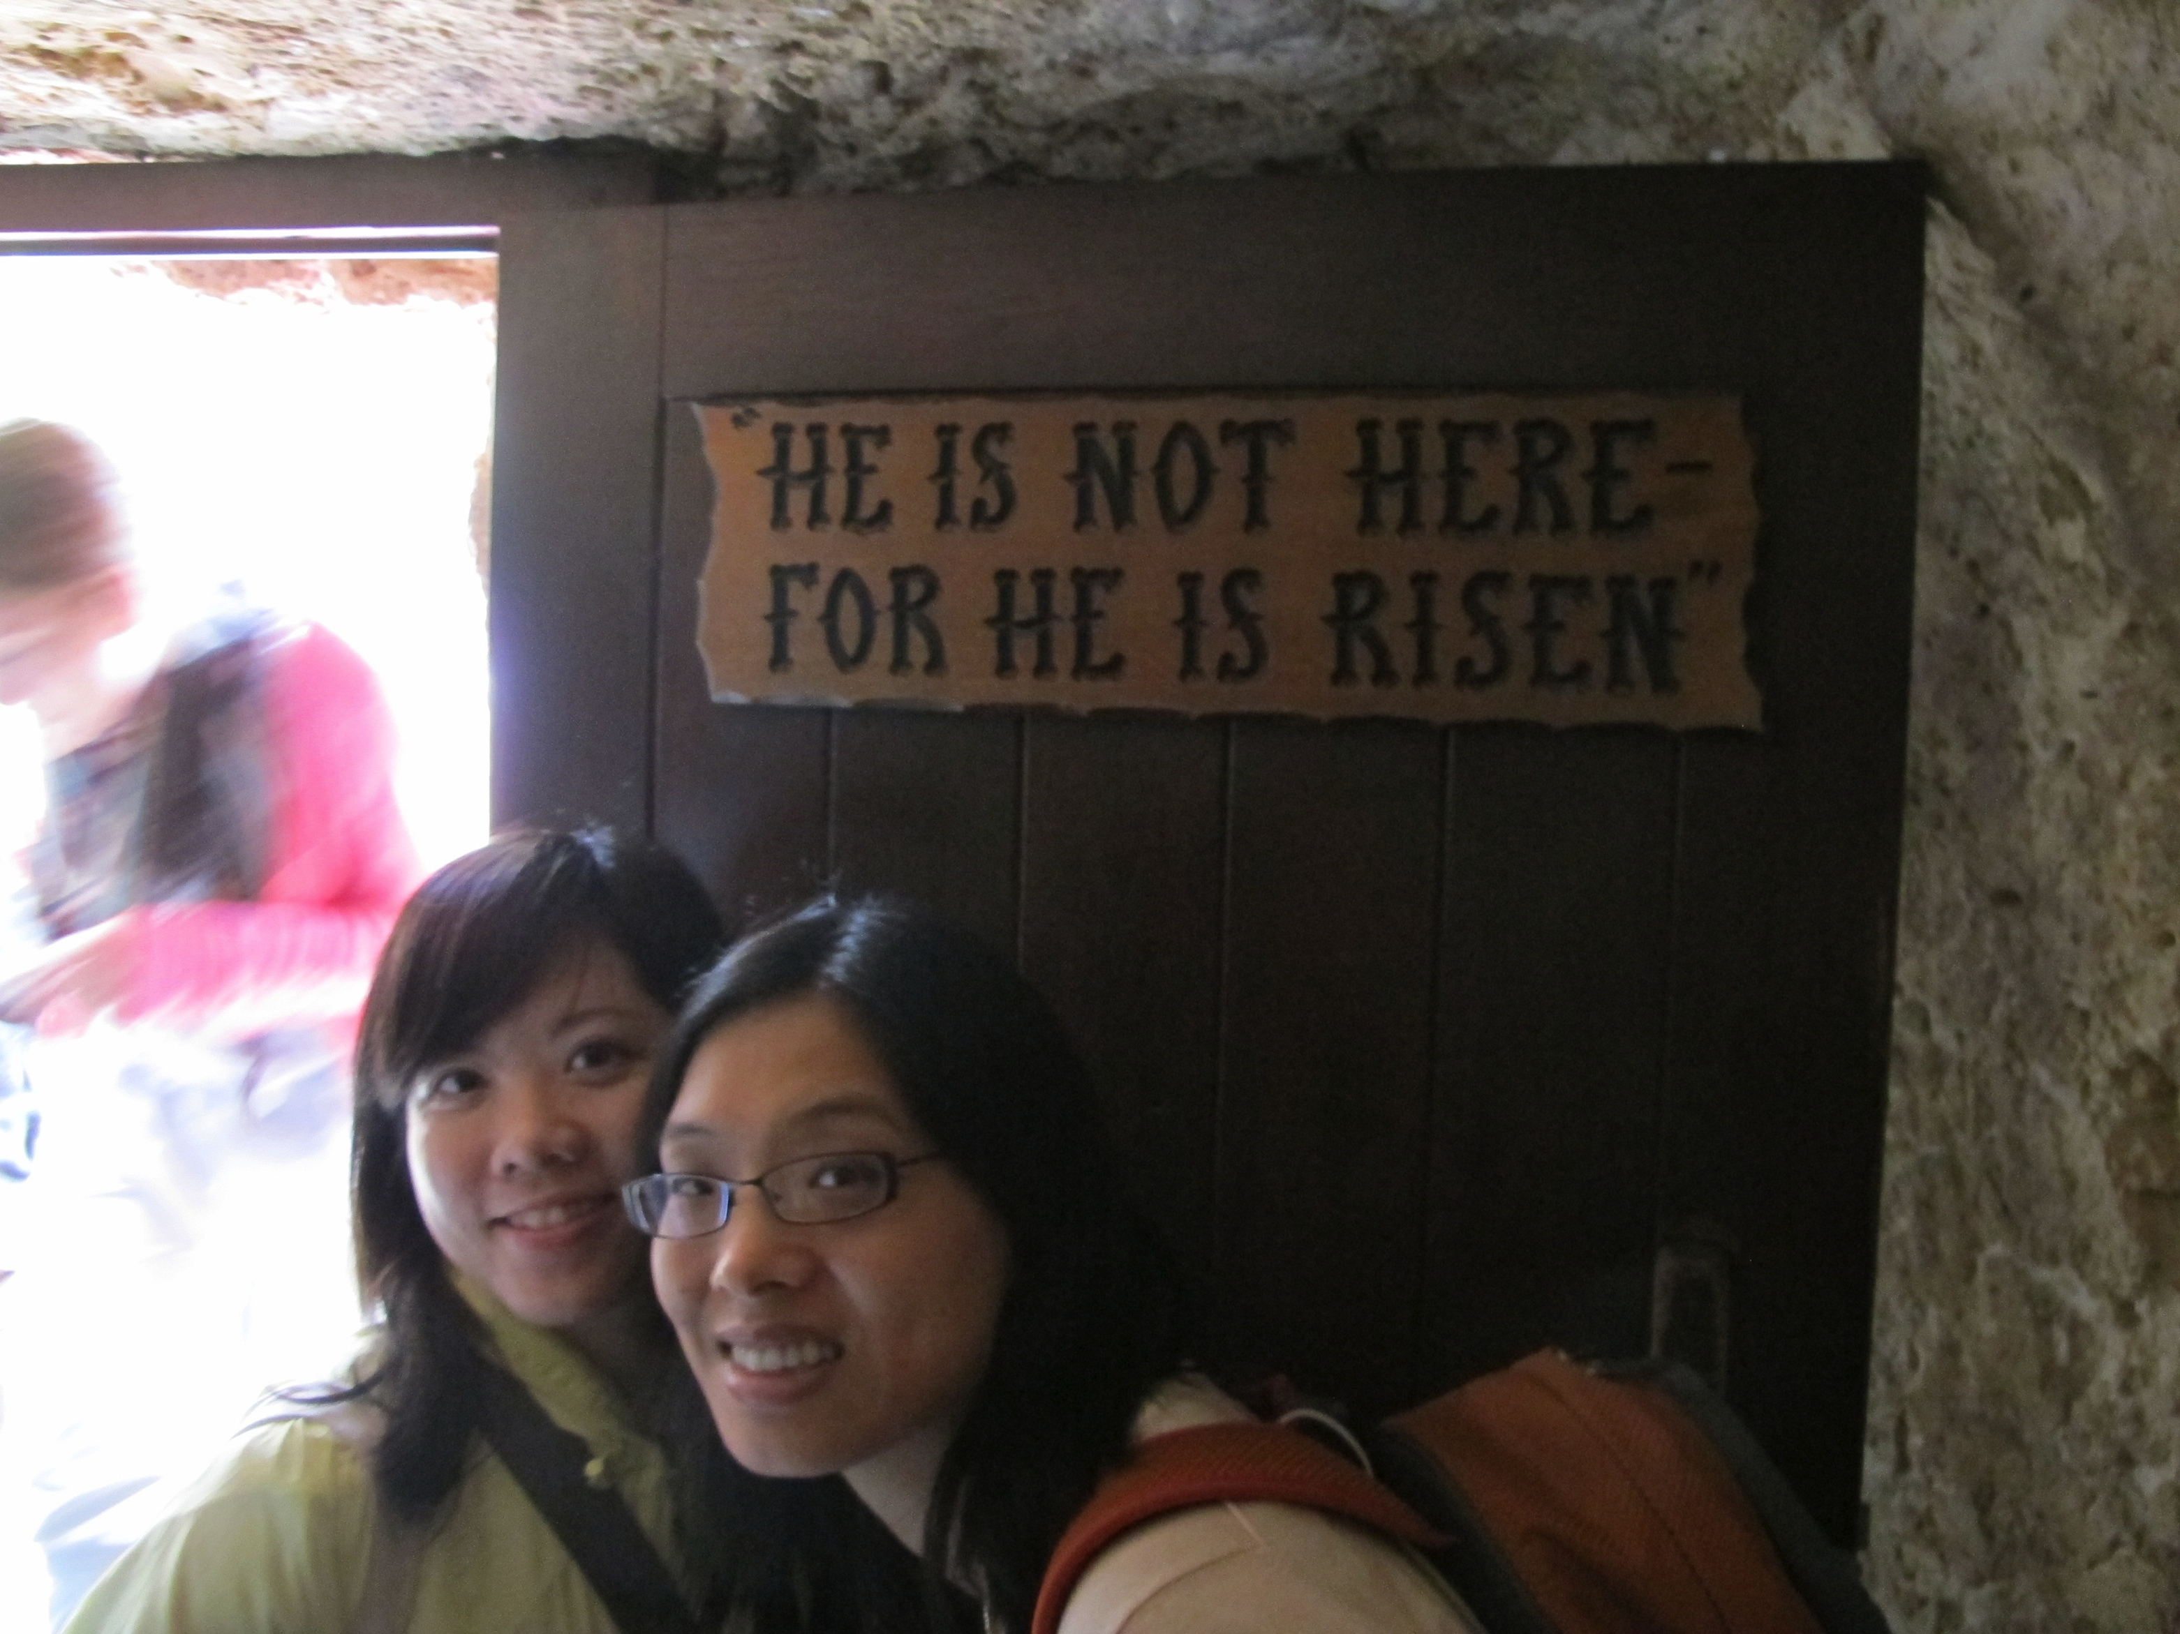
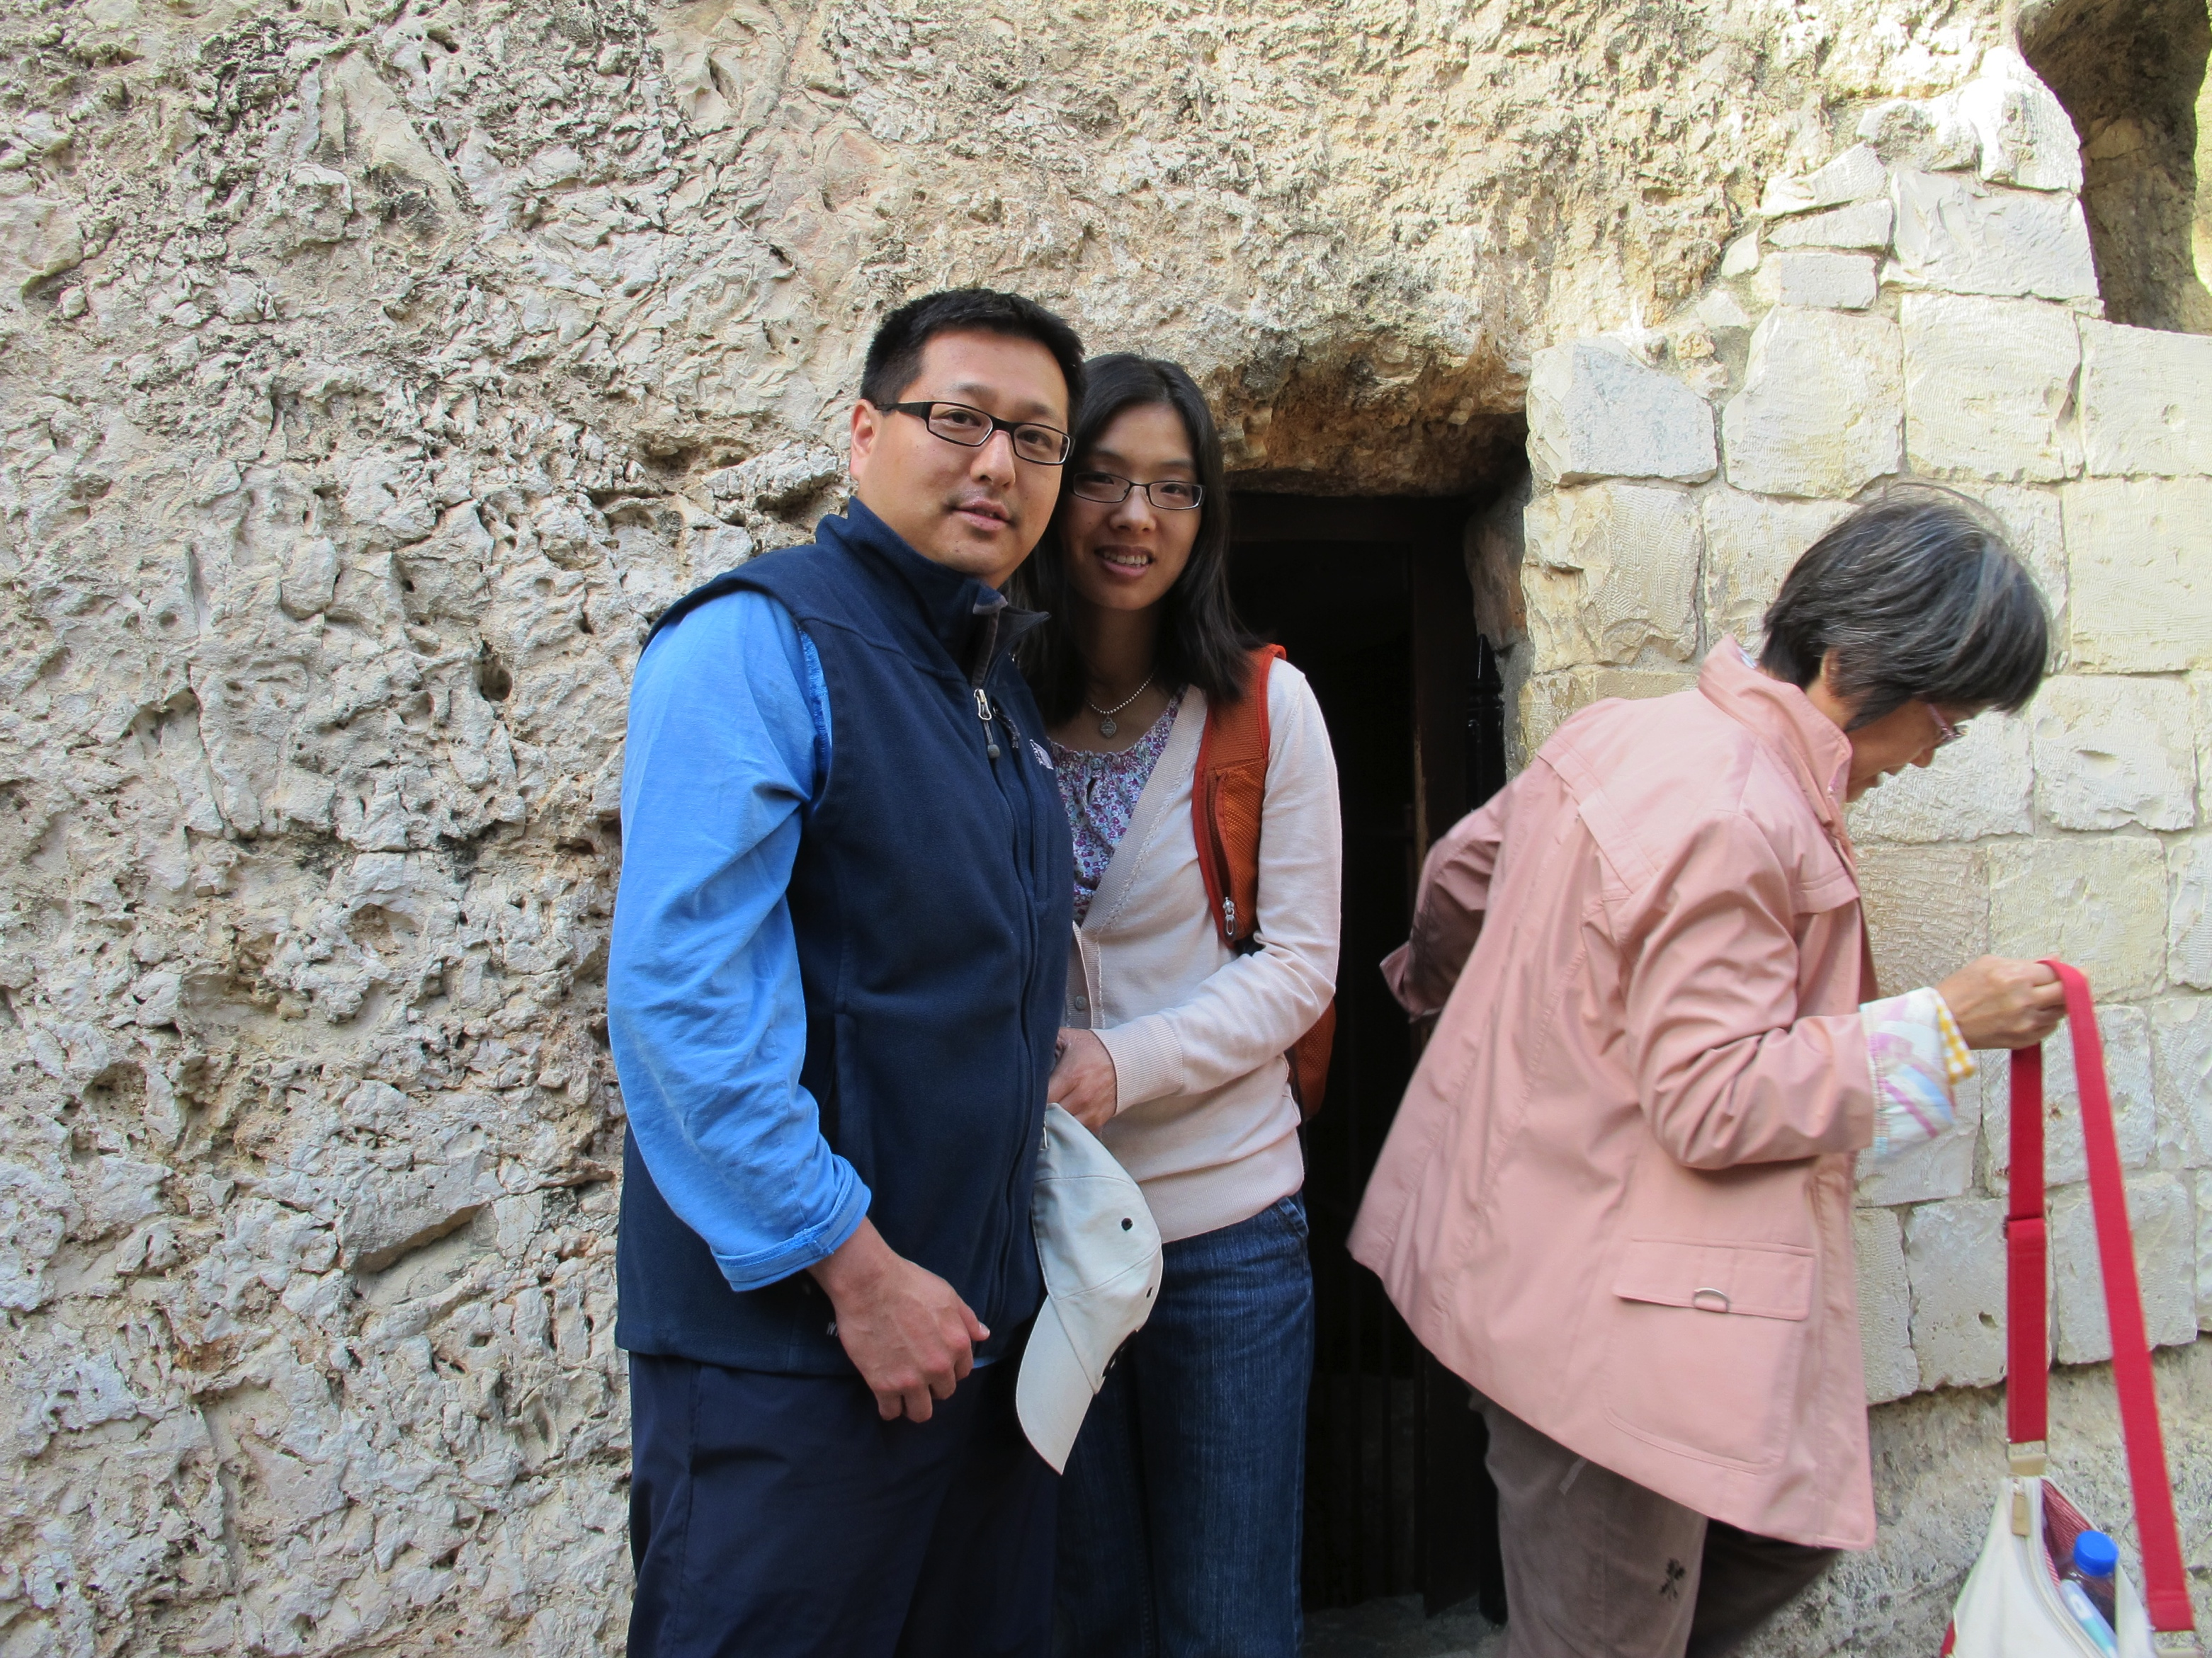

Slide 6
Evidences of Resurrection:
Broken Roman seal
Empty Tomb with 3 Possible Alternative Theories:
      a. 3 women rolled away the stone and stole Jesus’ body.
      b. The disciples fought the Roman soldiers, rolled away the stone, and stole the body.
      c. Romans themselves stole and body of Jesus and hid it.
      Over 500 witnesses
      Resurrection is a FACT:
      The life of the disciples. What changed? From hiding to going everywhere telling the message of the risen Christ. Did they receive prestige, wealth, increased social status or material benefits? 11 of the 12 apostles died for the truth of the scripture.
      2. The life of Paul. From persecuting Christians to the great Apostle Paul, penning a large portion of the NT.

Slide 7
What does the “resurrection” mean to us?
The resurrection means that we have assurance of our own resurrection: For if we believe that Jesus died and rose again, even so God will bring with Him those who sleep in Jesus (1Thess 4:14)
V. 7 Go and tell. This applies to the women, the disciples, and to us.
V. 7 His disciples; and Peter: Jesus still wanted to meet with them even though they failed Him so deeply. Why Peter by name? Perhaps He had a special hope, forgiveness, plan of restoration for the one who denied Him the worst.
Jesus had a special message for those who doubted like Thomas:
“I am the way, the truth, and the life; no one comes to the Father but through Me” (John 14:6)

Slide 8
B) Our Response (Mark 16:9-20)
9Now after He had risen early on the first day of the week, He first appeared to Mary Magdalene, from whom He had cast out seven demons. 10 She went and reported to those who had been with Him, while they were mourning and weeping. 11 When they heard that He was alive and had been seen by her, they refused to believe it. 12 After that, He appeared in a different form to two of them while they were walking along on their way to the country. 13 They went away and reported it to the others, but they did not believe them either. 14 Afterward He appeared to the eleven themselves as they were reclining at the table; and He reproached them for their unbelief and hardness of heart, because they had not believed those who had seen Him after He had risen. 15 And He said to them, “Go into all the world and preach the gospel to all creation. 16 He who has believed and has been baptized shall be saved; but he who has disbelieved shall be condemned. 17 These signs will accompany those who have believed: in My name they will cast out demons, they will speak with new tongues; 18 they will pick up serpents, and if they drink any deadly poison, it will not hurt them; they will lay hands on the sick, and they will recover.”
19 So then, when the Lord Jesus had spoken to them, He was received up into heaven and sat down at the right hand of God. 20 And they went out and preached everywhere, while the Lord worked with them, and confirmed the word by the signs that followed.

Slide 9
In many Bibles, this last portion of Mark is footnoted indicating that it did not exist in the early Greek manuscripts of the gospel of Mark. However many early Christian writers refer to this passage in their writings, which shows that they knew it was there and accepted it.
You might question the reliability of the Bible at this point ???
Homer’s Iliad, Plato’s writings, Caesar Gallic Wars are all recognized, studied, and taught as historic and accurate writings.
3 ways to examine and test if a certain document or writing is accurate:
a. The number of copies
b. The time interval between the original and existing copies
c. The degree of accuracy of the copies

Slide 10
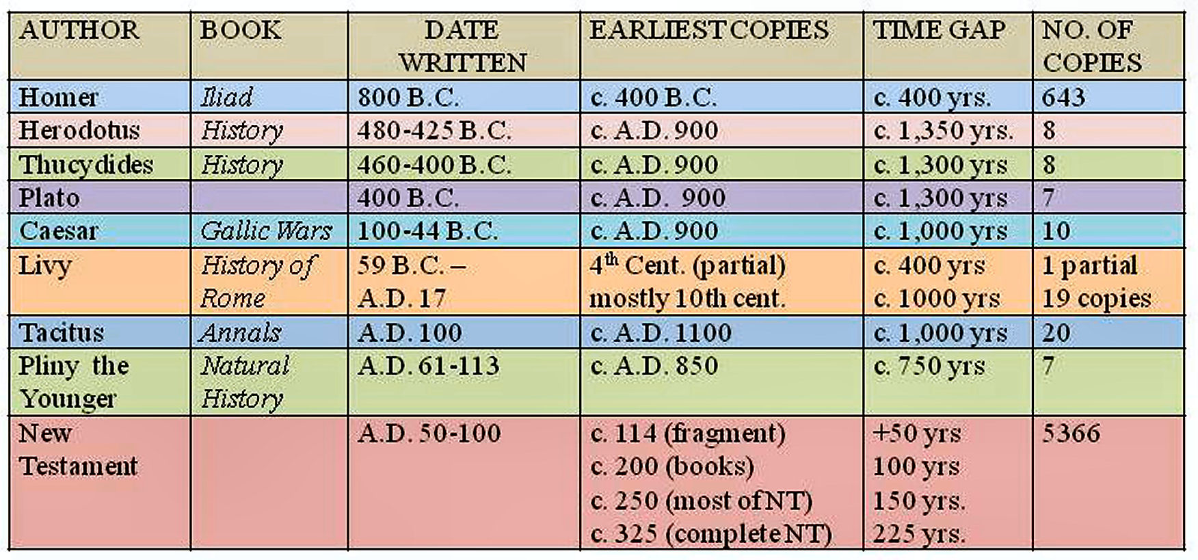
Taken from Josh McDowell’s “Evidence that Demands a Verdict”
Notes:
Over 500 copies of the NT is just in Greek, over 25,000 total in different translations

Slide 11
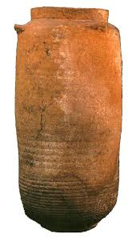
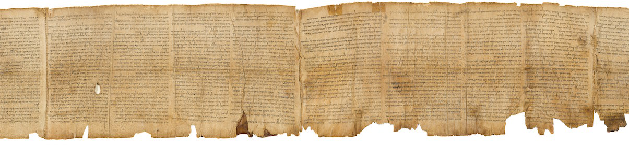
Importance of the Dead Sea Scrolls
Discovery occurred in 1947 in Qumran (a village situated about 20 miles east of Jerusalem)
Scrolls were found in ceramic pots containing leather and papyrus scrolls of the Hebrew Old Testament including Isaiah 53 which foreshadows Jesus, the coming Messiah.
The scrolls were in excellent condition after being hidden for so long (2000 years)
Shows and proves that God has preserved His Word down through the centuries, protecting it from extinction and guarding it against significant error.

Slide 12
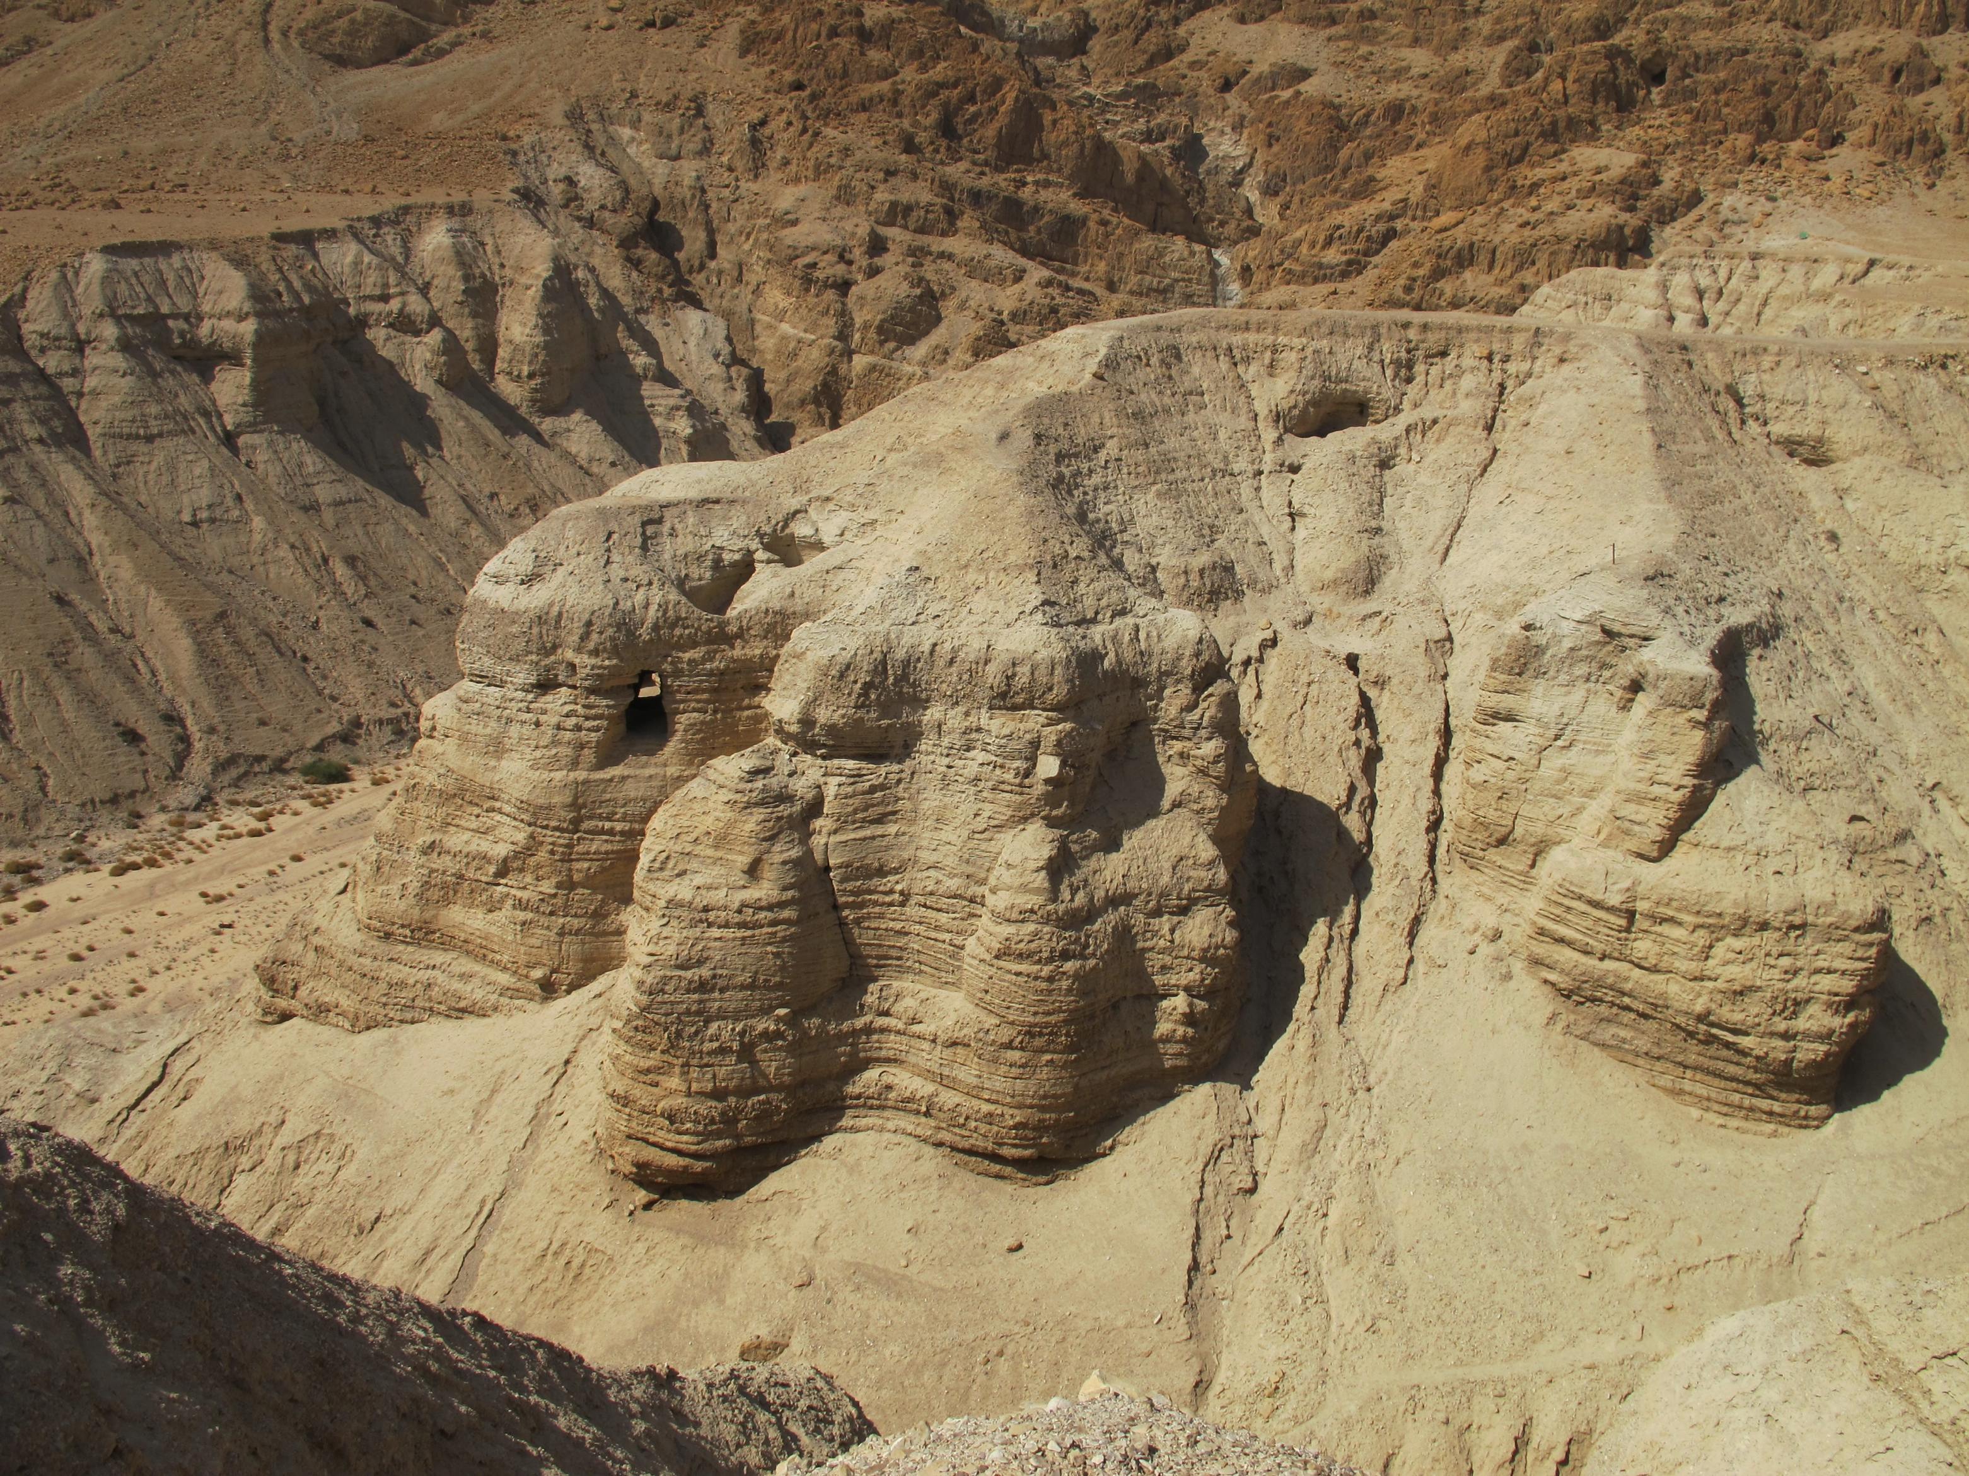

Slide 13
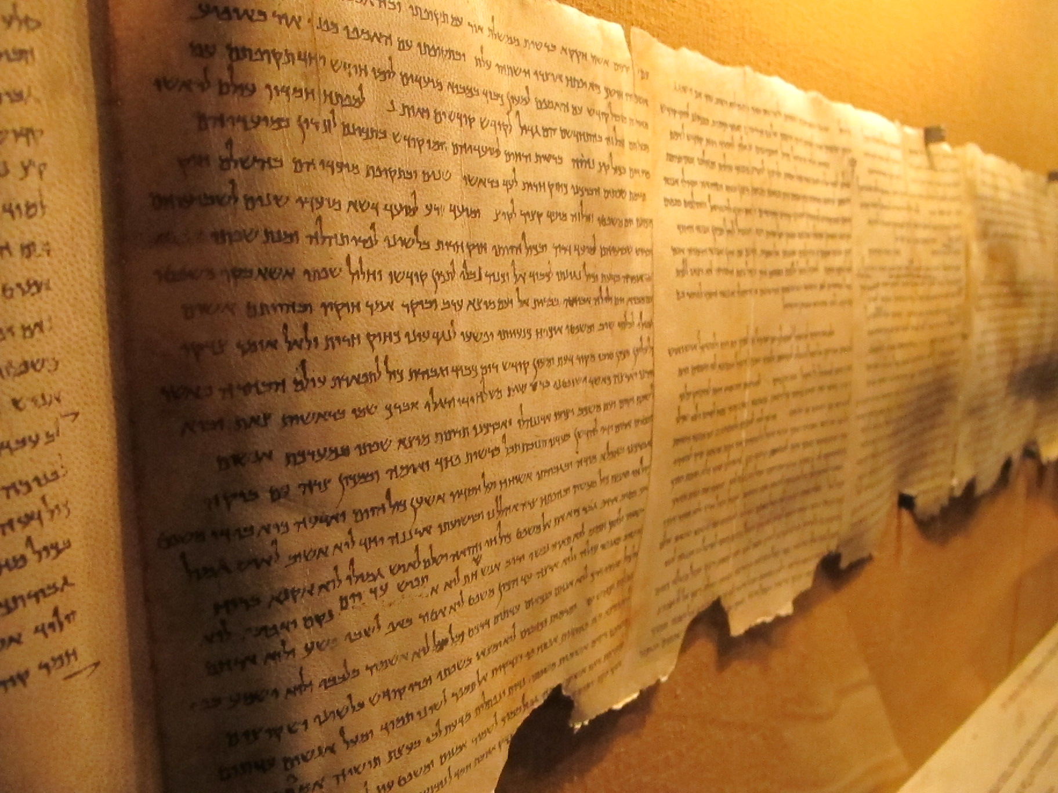

Slide 14
9Now after He had risen early on the first day of the week, He first appeared to Mary Magdalene, from whom He had cast out seven demons. 10 She went and reported to those who had been with Him, while they were mourning and weeping. 11 When they heard that He was alive and had been seen by her, they refused to believe it. 12 After that, He appeared in a different form to two of them while they were walking along on their way to the country. 13 They went away and reported it to the others, but they did not believe them either. 14 Afterward He appeared to the eleven themselves as they were reclining at the table; and He reproached them for their unbelief and hardness of heart, because they had not believed those who had seen Him after He had risen. 15 And He said to them, “Go into all the world and preach the gospel to all creation. 16 He who has believed and has been baptized shall be saved; but he who has disbelieved shall be condemned.
Appearances of a risen Lord (v. 9-16):
Mary Magdalene (v. 9-11): Jesus sent her to tell the other disciples that He had risen from the dead.
  2 disciples on the way to Emmaus (v.12-13): disciples still unwilling to believe.
  11 disciples (v. 14-18): encouraged them to go into the world and preach the gospel to every creature.

Slide 15

17 These signs will accompany those who have believed: in My name they will cast out demons, they will speak with new tongues; 18 they will pick up serpents, and if they drink any deadly poison, it will not hurt them; they will lay hands on the sick, and they will recover.”
Special Protection from the Lord (v.17-18) when serving Him.
Notes:
Add examples of STM in China with the noodle bowls.
Special protection from the authorities when we were at the retreat site in China. When they came into our room to search for Bibles.

Slide 16
19 So then, when the Lord Jesus had spoken to them, He was received up into heaven and sat down at the right hand of God. 20 And they went out and preached everywhere, while the Lord worked with them, and confirmed the word by the signs that followed.
Ascension of Jesus (v. 19-20)
Jesus had to ascend so that confidence would be put in the power and ministry of the Holy Spirit and not in the geographical presence of Jesus.
Take His rightful place at the right hand of God. His work is finished.
Disciples went out and preached everywhere.
Lord working with them and confirm the word through the accompanying signs.
      Disciples did what Jesus told them to do, and then Jesus did what only He could do.
    The final verse continues to this day. The followers of Jesus are still preaching everywhere with the help of the Lord, and He is still confirming His word through accompanying signs.

Slide 17
Discussion Questions
What does the resurrection of Jesus mean to you and how does that affect your daily decisions?
In what ways are you participating in the work of the Lord today? How do we know that we are doing His work?

