Slide 1
Understanding the End of the Ages
Raymond Breckenridge Orr
Mark 13:1-37

Slide 2
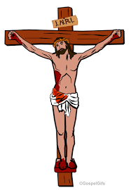
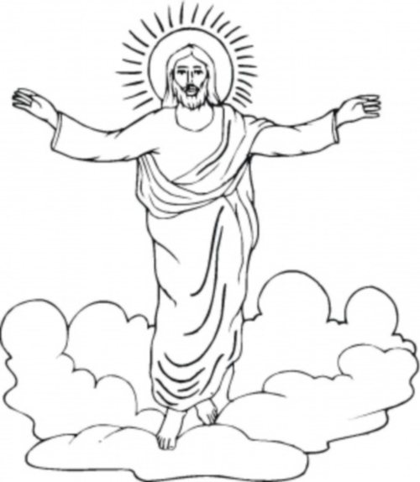
Understanding the End of the Ages
Destruction of the Temple (Mark 13:1-2)
Sign of the End of the Ages (Mark 13:3-13)
The Great Tribulation (Mark 13:14-23)
Coming of the Son of Man (Mark 13:24-27)
Lesson of the Fig Tree (Mark 13:28-31)
Exhortation to Be on Guard (Mark 13:32-37)
Questions for Discussion:

Slide 3
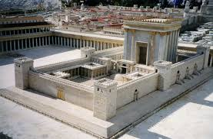
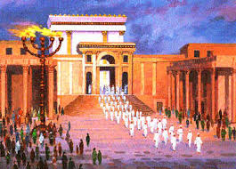
Destruction of the Temple:
¹ “And as he came out of the temple, one of his disciples said to him, ‘Look, Teacher, what wonderful stones and what wonderful buildings!’
² And Jesus said to him, ‘Do you see these great buildings? There will not be left here one stone upon another that will not be thrown down’.” (Mark 13:1-2)

Slide 4
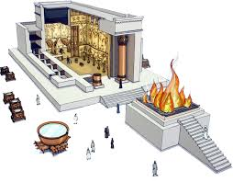
Destruction of the Temple:
Original temple was completed in 7 years, built by Solomon 969-962 BC – (1 Kings 6:38).
It was utterly plundered and then destroyed about 586 BC by the Chaldean army.
Nearly 50 years later the altar sacrifice was rebuilt (Ezra 3:3,8). It supposedly took another 20 years to complete the rebuilding of the temple.
In 168 BC this 2nd temple was plundered and defiled by Epiphanes,
After Jerusalem’s capture by Pompey, Crassus took away its treasures once again in 54/53 BC.
Begun in 19 BC, Herod the Great modified the temple complex, enlarging and enhancing its beauty.
The temple’s final destruction occurred in 70 AD, as the true temple of God had been faithfully manifest in human flesh in Jesus Christ.

Slide 5
Sign of the End of the Ages
³ “And as he sat on the Mount of Olives opposite, Peter and James and John and Andrew asked him privately, ⁴ ‘Tell us, when will these things be, and what will be the sign when all these things are about to be accomplished?’ ⁵ And Jesus began to say to them, ‘See that no one leads you astray. ⁶ Many will come in my name, saying ‘I am he!’ and they will lead many astray. ⁷ And when you hear of wars and rumors of wars, do not be alarmed. This must take place, but the end is not yet. ⁸ For nation will rise against nation, and kingdom against kingdom. There will be earthquakes in various places; there will be famines. These are but the beginning of the birth pains. (Mark 13:3-8)

Slide 6
Sign of the End of the Ages
⁹ “But be on your guard. For they will deliver you over to councils, and you will be beaten in synagogues, and you will stand before governors and kings for my sake, to bear witness before them. ¹⁰ And the gospel must first be proclaimed to all nations. ¹¹ And when they bring you to trial and deliver you over, do not be anxious beforehand what you are to say but say whatever is given you in that hour, for it is not you who speak, but the Holy Spirit. ¹² And brother will deliver brother over to death, and the father his child, and children will rise against parents and have them put to death. ¹³ And you will be hated by all for my name’s sake. But the one who endures to the end will be saved.” (Mark 13:9-13)

Slide 7
Sign of the End of the Ages
Context: The “beginning of the birth pains” is marked by wars, disruptions in nature and false, deceiving Christs who seek to lead the people of God astray. Temporal judgments point to an ultimate judgment to come.
Responsibility: Jesus warned his followers to keep vigilant surveillance in the coming times of severe testing. Disciples are to “hear” (v.7) & “see” (vs.14,26,29).
Warning …
a.) because of the deception of those claiming to be Christ or claiming the end has come,
b.) in view of persecution from religious leaders, family and any who might oppose the elect,
and…c.) calling them to always be ready for the sudden, return of the Son of Man, in power and glory.

Slide 8
The Great Tribulation
¹⁴ “But when you see the abomination of desolation standing where he ought not to be (let the reader understand), then let those who are in Judea flee to the mountains. ¹⁵ Let the one who is on the housetop not go down, nor enter his house, to take anything out, ¹⁶ and let the one who is in the field not turn back to take his cloak. ¹⁷ And alas for women who are pregnant and for those who are nursing infants in those days! ¹⁸ Pray that it would not happen in winter. ¹⁹ For in those days there will be such tribulation as has not been from the beginning of the creation that God created until now, and never will be…” (Mark 10:14-19)

Slide 9
The Great Tribulation
²⁰ And if the Lord had not cut short the days, no human being would be saved. But for the sake of the elect, whom he chose, he shortened the days. ²¹ And then if anyone says to you, ‘Look here is the Christ!’ or ‘Look, there he is!’ do not believe it. ²² For false Christs and false will arise and perform signs and wonders, to lead astray, if possible, the elect. ²³ But be on guard; I have told you all things beforehand.” (Mark 10:20-23)

Slide 10
The Great Tribulation
1. Jesus refers to “the abomination of desolation”, stating that ‘it’ or ‘he’ will be seen “standing where he (it) ought not be”.
Luke stipulates it will occur “when you see Jerusalem surrounded by armies”.
Matthew explains the abomination “standing in the holy place” pertains directly to that “spoken of through the prophet Daniel”.
2. Four passages are alluded to in Daniel referring to (Dan.8:13 ; 9:27 ; 11:31 ; 12:11).
a. the rebellion of God’s people,
b. an abomination to be set up in the temple,
c. the destruction of both city and sanctuary at an appointed time of the end, and
d. a sealed knowledge that only those who are wise will be able to understand.
3. This event both precedes and points to the coming of God’s holy
judgment meted out upon humanity. {1st cent. & 2nd final coming}

Slide 11
The Great Tribulation
Jesus’ teaching focused upon the “elect” (vs.20,22,27) for whom he died, a humanity judged and redeemed for all eternity. The “birth pains” would be times of testing for his chosen disciples who were to encounter deception and hardship along the way (vs.5-8). These would be times to make a faithful witness by the power of the Holy Spirit, as each “endures to the end” (vs.9-13).
For all those who “understand”, a time was coming to “flee to the mountains”; when dreadful judgment would be poured out (vs.14-23). But also, “in those days, after the tribulation”, there would be a glorious coming of the Son of Man in great power to consummate his kingdom (vs.24-27).
Jesus words were meant to strengthen and encourage his followers as they encountered these times of testing.

Slide 12
Coming of the Son of Man
²⁴ “But in those days, after the tribulation, the sun will be darkened, and the moon will not give its light, ²⁵ and the stars will be falling from heaven, and the powers of the heavens will be shaken. ²⁶ And then they will see the Son of Man coming in clouds with great glory and power. ²⁷ And then he will send out the angels and gather his elect from the four winds, from the ends of the earth to the ends of heaven. (Mark 13:24-27)
Notes:
Alleluia!

Slide 13
Coming of the Son of Man
Four disciples ask a double-edged question of “when will these things be, and what will be the sign when all these things are about to be accomplished?” (v.4). In Matthew’s account the question expands to include “what will be the sign of your coming and of the end of the age” (Mat.24:3). Jesus’ disciples would have easily connected this declaration of the temple’s destruction with the return of Christ and the coming of the kingdom.
Luke’s account runs parallel to Mark’s in that there will be “great signs in heaven” (Lk.21:11), “there will be signs in the sun, moon and stars (Lk.21:25). But in Matthew’s account, Jesus reveals that his return will be marked out when a “sign of the Son of man will appear in the sky, and all the nations of the earth will mourn” and that this return will be accompanied by a “loud trumpet call” (Mat.24:30,31).
Notes:
Alleluia!

Slide 14
Coming of the Son of Man
Eschatological Parousia: God coming at the end of an age vs.24-25
In Isaiah it is linked to the Old Testament “day of the Lord”, a “day of his burning anger” where God’s severe judgment will be meted out against all the world’s wicked behavior (Isa.13:6,9-13).
In Joel, it connects to “those days” when Israel’s deliverance will be accompanied by both “wonders in heaven and on the earth” (Joel 2:28-3:2). These occur “before the coming of the great and dreadful day of the Lord”, allowing for a time to repent and be saved. “In those days and at that time” judgment of all nations will be concurrent with the restoration of God’s people.
Luke’s record (Acts 2:2-3 ; 16-24,33), reveals fulfillment of Joel’s prophecy occurred with Jesus’ incarnation, death, resurrection, and out-pouring of God’s H.S. Prophesied to happen “in the last days” and fulfilling God’s ancient promise, these parallel the biblical concept of God’s Kingdom, fully begun here and now, while yet to come in full and final fulfillment.
Notes:
Alleluia!

Slide 15
Lesson of the Fig Tree
²⁸ “From the fig tree learn its lesson: as soon as its branch becomes tender and puts out its leaves, you know that summer is near. ²⁹ So also, when you see these things take place, you know that he is near, at the very gates. ³⁰ Truly, I say to you, this generation will not pass away until all these things take place. ³¹ Heaven and earth will pass away, but my words will not pass away.” (Mark 13:28-31)
Notes:
Alleluia!

Slide 16
Lesson of the Fig Tree
The “lesson” of the fig tree (v.28) answers the prophecy Jesus spoke (v.2), & the disciples’ question (v.4). At Passover time, the fig branches would have been tender and the leaves sprouting. This gave imminent meaning to Jesus’ words: “this generation will not pass away until all these things take place” (v.30).
Jesus death was near and Jerusalem’s destruction was in full view. Thus as “the fig tree” points to the approach of summer, so also “these things taking place” symbolize the period when the “kingdom of God is near” (Lk.21:29,31).
2. Jesus’ prophetic word has ‘end of the age’ relevance: “And the gospel must first be proclaimed to all nations” (v.10). “For in those days there will be such tribulation as has not been from the beginning of the creation that God created until now, and never will be” (v.19). “They will see the Son of Man coming in clouds with great glory and power” (v.26), to “gather his elect from the four winds” (v.27). *** Like the visible sign of the fig tree,
these things must precede and facilitate the coming of Christ.
Notes:
Alleluia!

Slide 17
Lesson of the Fig Tree
3. Jesus has asserted the knowable: “I have told you all things beforehand” (v.23), “… when you see these things take place, you know that he is near…” (v.29), and “this generation will not pass away until all these things take place” (v.30).
He speaks of “those days” (vs.17,19,20,24), & of “then” (vs.21,26); interchangeable expressions in regard to the TIME period that they signify, covering the WHOLE scope encompassed by “all things” (v.23) and “these things” (vs.3,4,30).
The notion of “these things” and “those days” applies to “this generation” (v.30), but in context, they also extend further to include the time when “heaven and earth will pass away”.
*** Mark, Luke, and Matthew all record these in parallel relationship. The application of Jesus’ words cannot be limited to a single event in human history.
Notes:
Alleluia!

Slide 18
Exhortation to Be on Guard!
³² “But concerning that day and that hour, no one knows, not even the angels in heaven, nor the Son, but only the Father. ³³ Be on guard, keep awake. For you do not know when the time will come. ³⁴ It is like a man going on a journey, when he leaves home and puts his servants in charge, each with his work, and commands the doorkeeper to stay awake. ³⁵ Therefore stay awake---for you do not know when the master of the house will come, in the evening of at midnight, or when the rooster crows, or in the morning--- ³⁶ lest he come suddenly and find you asleep. ³⁷And what I say to you, I say to all: stay awake.” (Mark 13:32-37)
Notes:
Alleluia!

Slide 19
Exhortation to Be on Guard
Jesus sets limits: “… concerning that day and that hour, no one knows, … only the Father” (v.32), “For you do not know when the time will come.” (v.33), “for you do not know when the master of the house will come.” (v.35).
Jesus’ command, that everyone “be on guard”, “be alert”, or “stay awake” (vs.9,23,33,35-36), was relevant to the disciples’ immediate situation, as well as to all who would come after them; when God would gather “his elect from the four winds, from the ends of the earth to the ends of the heaven” (v.27).
*** In Summary: In Mark’s account, there were to be multiple signs that accompany the coming of God’s kingdom. Those witnessing Christ’s resurrection and the judgment of Jerusalem in 70 AD experienced the first fruits of God’s kingdom come and the end of the age begun, but the full import of Jesus’ words are yet to have their complete application. Thus, all God’s people throughout the ages are to heed and obey Jesus’ manifold command.
Notes:
Alleluia!

Slide 20
Discussion Questions:
What birth pains do you see going on in the world today?
How should we apply Jesus’ warning to stay awake and be on guard in our time?

