Slide 1
The Motives of Men’s Heart
Mark 12:28-44
Calvin Chiang

Slide 2
A) The Greatest Commandment? (Mark 12:28-34)
28One of the scribes came and heard them arguing, and recognizing that He had answered them well, asked Him, “What commandment is the foremost of all?” 29 Jesus answered, “The foremost is, ‘Hear, O Israel! The Lord our God is one Lord; 30 and you shall love the Lord your God with all your heart, and with all your soul, and with all your mind, and with all your strength.’ 31 The second is this, ‘You shall love your neighbor as yourself.’ There is no other commandment greater than these.” 32 The scribe said to Him, “Right, Teacher; You have truly stated that He is One, and there is no one else besides Him; 33 and to love Him with all the heart and with all the understanding and with all the strength, and to love one’s neighbor as himself, is much more than all burnt offerings and sacrifices.” 34 When Jesus saw that he had answered intelligently, He said to him, “You are not far from the kingdom of God.” After that, no one would venture to ask Him any more questions.

Slide 3
Background Info
Jesus had just been approached and rejected by all of Israel’s religious governing body, the Sanhedrin. The last group to question Jesus was the Sadducees who had lots of money and power in the Jewish community.
Then one of the scribes who had good intentions and was looking on asked Jesus what the greatest commandment of all is. Jesus quotes from Deut 6:4-5 (referred to as the Shema “to hear”; recited by all Jews every morning), and Lev 19:18 and combines them into one. These two cannot be separated because love of God and love of others are one in the same. Just like in James, we cannot say we love God while hating on our brother and neglecting the needs of others.
Deut 6:4-5
4 “Hear, O Israel! The Lord is our God, the Lord is one! 5 You shall love the Lord your God with all your heart and with all your soul and with all your
might.
Lev 19:18
18 You shall not take vengeance, nor bear any grudge against the sons of your people, but you shall love your neighbor as yourself; I am the Lord.
Notes:
*Scribe is trying to ask Jesus to summarize all 613 rules that the Jews had to follow in their daily lives.
*Example of the hotel in Israel, breakfast plates does not mix with dinner. Dairy does not mix with meat. If it was ever found out that they mixed the plates, hotel would needed to be shut down.
*Sabbath, made the mistake of riding the Sabbath elevator…touched the buttons by a heathen.

Slide 4
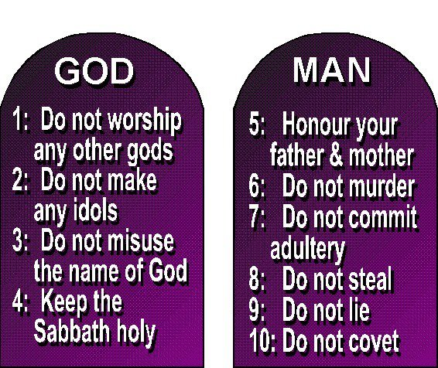
The Ten Commandments
Looking at the Ten Commandments, first 4 can be summarized as Loving God, while the next 6 can be summarized as Loving others.
Love is not an emotion, but rather it is a commitment to respect and to care. In Lev, the command to love one’s neighbor is followed by confronting one’s neighbor in a constructive way so that there is no feeling of revenge, hatred, and results in a grudge.
Temple is no longer needed as the scribe understood the Kingdom of God is not a physical building and that the sacrifices are a response to God’s favor instead of trying to gain favor from God.
Greatest Commandment can be summarized as:
“Making disciples by loving God and loving neighbors”
Notes:
*love is greater than the animal sacrifices made at the temple.

Slide 5
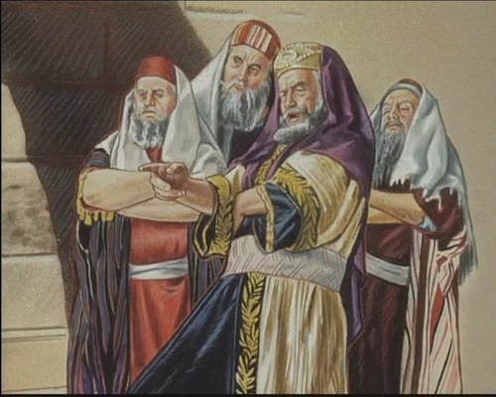
A) The Heart of the Scribes (Mark 12:38-40)
38 In His teaching He was saying: “Beware of the scribes who like to walk around in long robes, and like respectful greetings in the market places, 39 and chief seats in the synagogues and places of honor at banquets, 40 who devour widows’ houses, and for appearance’s sake offer long prayers; these will receive greater condemnation.”
Notes:
*Scribes in the time of the NT belonged to the sect of the Pharisees. They were the public teachers of the people and often clashed with Jesus. They were also hostile towards the apostles as well.

Slide 6
Jesus is exposing the heart of most of the scribes (we just met one that was not like this). In their zeal to interpret and keep the law, the scribes are missing the point because they do not love God.
What do they love instead?
Jesus wants us to see is that true piety and genuine devotion and love toward God is something that can only come from the inside. It comes from the heart.
Notes:
The scribes are after the praise and respect of people. Pretending to love God to bring them honor and respect.
*What are some examples of this in our lives?
*Rides for the sisters....not brothers…We choose who we want to bless…
*

Slide 7
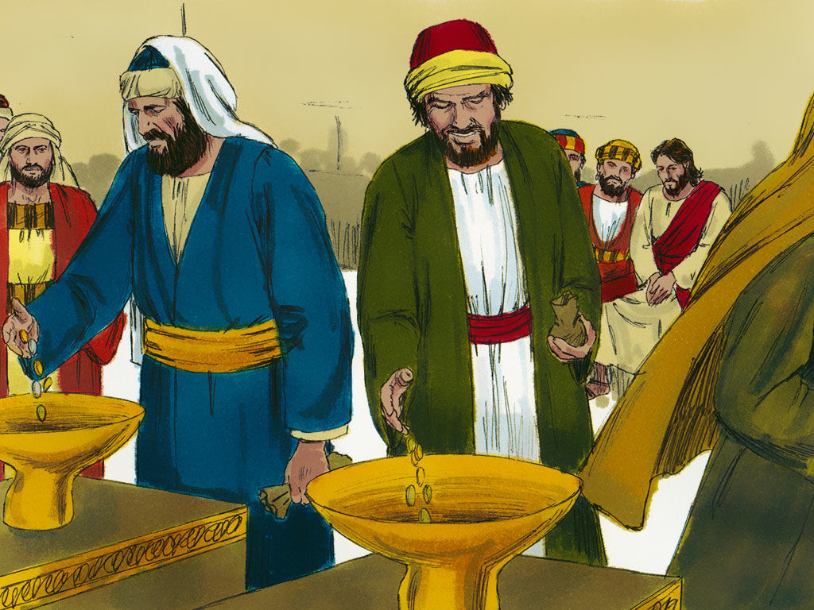
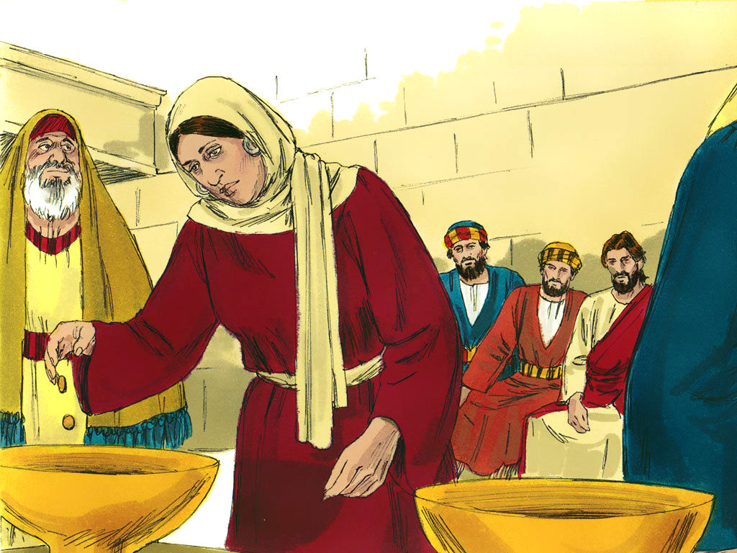
A) The Heart of the Widow (Mark 12:41-44)
41 And He sat down opposite the treasury, and began observing how the people were putting money into the treasury; and many rich people were putting in large sums. 42 A poor widow came and put in two small copper coins, which amount to a cent. 43 Calling His disciples to Him, He said to them, “Truly I say to you, this poor widow put in more than all the contributors to the treasury; 44 for they all put in out of their surplus, but she, out of her poverty, put in all she owned, all she had to live on.”

Slide 8
We are not able to determine someone’s devotion to God based on the size of their giving/offering.
What’s the difference between the offering of the widow versus others who also gave?
In the minds of the scribes, this woman was a sinner because she could not possibly give enough to please God. But Jesus presents this poor woman as a positive example of what it means to love God. She did so without show or fanfare, but in simple devotion and trust.
Notes:
*At OIF, you may have notice that we don’t collect offering. Why do you think we do that?
*Need to be careful in our serving…Are we trying to gain the spotlight when we serve. Those that are in more visible positions will have more temptations.

Slide 9
Jesus wants us to have the same mindset as the widow in order to enter in the kingdom of God. So what is this mindset?
We do not gain entry into God’s kingdom by putting on external displays of righteousness that only puff us up with pride. We don’t enter the kingdom of God by protecting and preserving our religious kingdoms while failing to love God and love our neighbors.
Notes:
*Nothing spectacular to offer to God. We cannot give anything to earn our standing in God’s eyes.
*Depending only on the righteousness of JC and placing our trust in him.

Slide 10
We do not gain entry into God’s kingdom by putting on external displays of righteousness that only puff us up with pride. We don’t enter the kingdom of God by protecting and preserving our religious kingdoms while failing to love God and love our neighbors.
Instead, entrance into the kingdom of God is granted only to those who, when faced with the Law of God, say, “I can’t do it. I need Christ to do it for me.” And in making that confession, Jesus gives us the righteousness God requires.
When we are filled with the Holy Spirit it teaches us how to properly love God and love our neighbors. Love for God and love for neighbor flows from what Jesus did for us on the cross. That is the basis for all of our love.
We love because he first loved us (1 John 4:19 ESV). And he proved his love for us in that “while we were still sinners, Christ died for us” (Romans 5:8 ESV).

Slide 11
Discussion Questions
If you were to evaluate your daily activities based on the basis of love for God and your sphere of influence, how would you do?
In what ways are we like the scribes in v. 38-40?
What implications does the example of the widow have for our giving to the Lord’s work?

