Slide 1
The Most Important Question
Raymond Breckenridge Orr
Mark 10:17-31

Slide 2
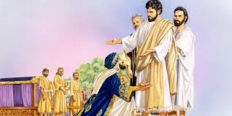
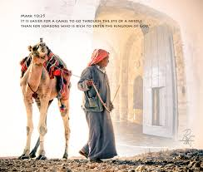
The Most Important Question
Right relationship to God: the young, rich ruler. ( (Mark 10:17-22)
Right relationship to God: the disciples & the Kingdom of God. (Mark 10:23-31)

Slide 3
¹⁷ “And as he was setting out on his journey, a man ran up and knelt before him and asked him, ‘Good Teacher, what must I do to inherit eternal life?’ ¹⁸ And Jesus said to him, ‘Why do you call me good? No one is good except God alone. ¹⁹ You know the commandments; Do not murder, Do not commit adultery, Do not steal, Do not bear false witness, Do not defraud, Honor your father and mother.’ ²⁰ And he said to him, ‘Teacher, all these I have kept from my youth.’ ²¹And Jesus, looking at him, loved him, and said to him, ‘You lack one thing: go, sell all that you have and give to the poor, and you will have treasure in heaven; and come, follow me.’ ²²Disheartened by the saying, he went away sorrowful, for he had great possessions.” (Mark 10:17-22)

Slide 4
Right relationship to God: the young, rich ruler
Context : Jerusalem: “as he was setting out on his journey”. from divorce → to children → to how material possessions influence us.
Approach: eager, respectful “Good Teacher”. Question “What must I do to inherit eternal life?” The man’s goal of piety was based on achievements (“. . what good deed must I do?” Mat.). Evidently he realizes that he lacked something.
Description: Matthew =“young man” Luke =“ruler” . In all 3 accounts “great possessions” was the source of idolatry and self-deception. Jesus directs him to view God alone as the source of all goodness: “Why do you call me good? No one is good except God alone.”

Slide 5
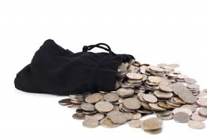
Right relationship to God: the young, rich ruler
Six commandments out of 10 center upon a person’s relationship to others. 1 commandment is notably modified: “Do not defraud” instead of “Do not covet” (Deut.5:21). Apparently, Jesus intended this to apply to the man’s situation.
“All these I have kept…” reveals a superficial understanding. Actually, it is through the law that we gain a real knowledge of sin, and our need of Christ. Jesus “loved him” showing him compassion in speaking the truth to him, “You lack one thing …”, This called for total surrender of achievements, his “great possessions”, to the be in right relationship to God through Jesus Christ.

Slide 6
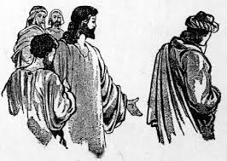
Right relationship to God: the young, rich ruler
6. Scribal legislation prohibited the reduction of all one’s possessions to poverty. Old Testament regarded wealth as the mark of God’s favor (Deut.28:1-14). The 3 major pillars of Jewish piety were (1) Almsgiving, (2) Fasting, & (3) Prayer but this did not mean becoming poor, only helping them as objects of God’s kind protection (Deut.15:7-11).
7. The rich, young, ruler departs in sadness, unwilling to put his complete dependence in Christ Jesus; the only answer to his quest for salvation. True
righteousness deals a death blow to the lust for this world’s satisfactions, as love of this world’s wealth bars us from a true love for Christ. The young ruler’s story warns that earnest seeking must be rightly channeled in complete surrender.

Slide 7
²³ “And Jesus looked around and said to his disciples, ‘How difficult it
will be for those who have wealth to enter the kingdom of God!’ ²⁴ And the disciples were amazed at his words. But Jesus said to
them again, ‘Children, how difficult it is to enter the kingdom of God! ²⁵ It is easier for the camel to go through the eye of a needle than for a
rich person to enter the kingdom of God.’ ²⁶ And they were
exceedingly astonished, and said to him, ‘Then who can be saved?’ ²⁷Jesus looked at them and said, ‘With man it is impossible, but not
with God. For all things are possible with God.’ ²⁸ Peter began to
say to him, ‘See we have left everything and followed you.’ ²⁹ Jesus
said, ‘Truly, I say to you, there is no one who has left house or
brothers or sisters or mother or father or children or lands, for my
sake and for the gospel, ³⁰ who will not receive a hundredfold now in
this time, houses and brothers and sisters and mothers and children
and lands, with persecutions and in the age to come eternal life. ³¹ But many who are first will be last, and the last first.” (Mark 10:23-31)

Slide 8
Right relationship to God: the disciples & the Kingdom of God.
The disciples “were amazed at his words” when Jesus spoke of the wealthy having difficulty entering God’s kingdom. Speaking to his “children”, Jesus explains the difficulty as “impossible” for man but “possible with God”.
An image of a large camel’s limitations causes the disciples to be “exceedingly astonished”. One possible explanation for the needle’s eye was a small postern-gate opening in the city wall, where a person could barely pass through but not a large camel. Christ confronted the notion that one’s goodness or wealth could bring a person into the kingdom. None by their own effort may enter God’s kingdom: because it is the gift of God alone that effects salvation.

Slide 9
Right relationship to God: the disciples & the Kingdom of God.
3. Peter, representing the group, speaks up but is not rebuked for his words. The “children” partially understood Jesus’ words, for they “left everything to follow” him. Yet now, the disciples are given a deeper glimpse into the true meaning of grace, challenged to press on to more fully embrace and understand it.
4. Jesus’ words of comfort include a promise of multiple blessing and a warning of persecutions. Blessing extends to the persecutions “in this present age”, yet the promise of blessing looks beyond the confines of history as well. The ultimate reward of the Kingdom is summed up in a simple phrase; “eternal life”. Jesus makes it clear that the blessing of God, in this life and the next, is manifold and marvelous.

Slide 10
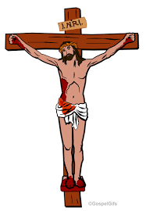
Right relationship to God: the disciples & the Kingdom of God.
5. The “many who are first will be last and the last first” builds on the notion of becoming a servant to all. The use of possessions can give evidence to God’s saving work. God’s Spirit must first apply the liberating power of what was accomplished on the cross to all who are called according to God’s purpose. What is impossible for man is truly possible for God who foreknows, predestines, calls, justifies & glorifies His children. Astonishing!
6. This answers ‘The Most Important Question’: “What must I do to inherit eternal life?” What we are to do is believe in who He is, as the unique Son of God; and what He has done, by dying in our place, that we may be saved from the just wrath of God to come. As repenting sinners we grow in the marked fruit of God’s Spirit that gives evidence to life eternal!
Notes:
Alleluia!

Slide 11
Discussion Questions:
Why did Jesus first point the man to the source of goodness, and then to the teaching of the law?
Does our Lord’s teaching oblige all true disciples to give everything to the poor and follow Him? Explain.
What caused the disciples to be so amazed? Why?

