Slide 1
Who is Jesus?
Mark 8:27-38
Calvin Chiang

Slide 2
A) Is Christ a Liar, Lunatic, or Lord? (Mark 8:27-30)
27 Jesus went out, along with His disciples, to the villages of Caesarea Philippi; and on the way He questioned His disciples, saying to them, “Who do people say that I am?” 28 They told Him, saying, “John the Baptist; and others say Elijah; but others, one of the prophets.” 29 And He continued by questioning them, “But who do you say that I am?” Peter answered and said to Him, “You are the Christ.” 30 And He warned them to tell no one about Him.
“Who do YOU say that I am?”

Slide 3
C.S. Lewis Trilemma: Is Christ a….
  Liar: Jesus made claims knowing that He wasn’t God. He was a good liar and a hypocrite telling others to live a Godly life while He lived a colossal lie.
        Cannot be true because whatever Jesus proclaimed, lives have been changed, nations have repented, and thieves have turned their lives around. Someone who was a phony couldn’t have results like that.
        Lunatic: Was Jesus crazy and fictional like the Easter bunny or Santa Claus?
                Didn’t display any abnormalities or imbalances that usually go hand in hand with being crazy.
        Spoke some of the most profound words that set free many individuals in bondage of many things.
        3. Lord: If Jesus is not a liar or lunatic, then He is who He claims to be, the Son of God.
Notes:
*Issue here isn’t which is possible but rather which is more likely? You cannot call Jesus a great moral teacher yet dismiss His claim to be the Son of God. If you do, then you have to say that He was either a liar or lunatic and cannot be a good moral teacher. You have to make that choice.

Slide 4
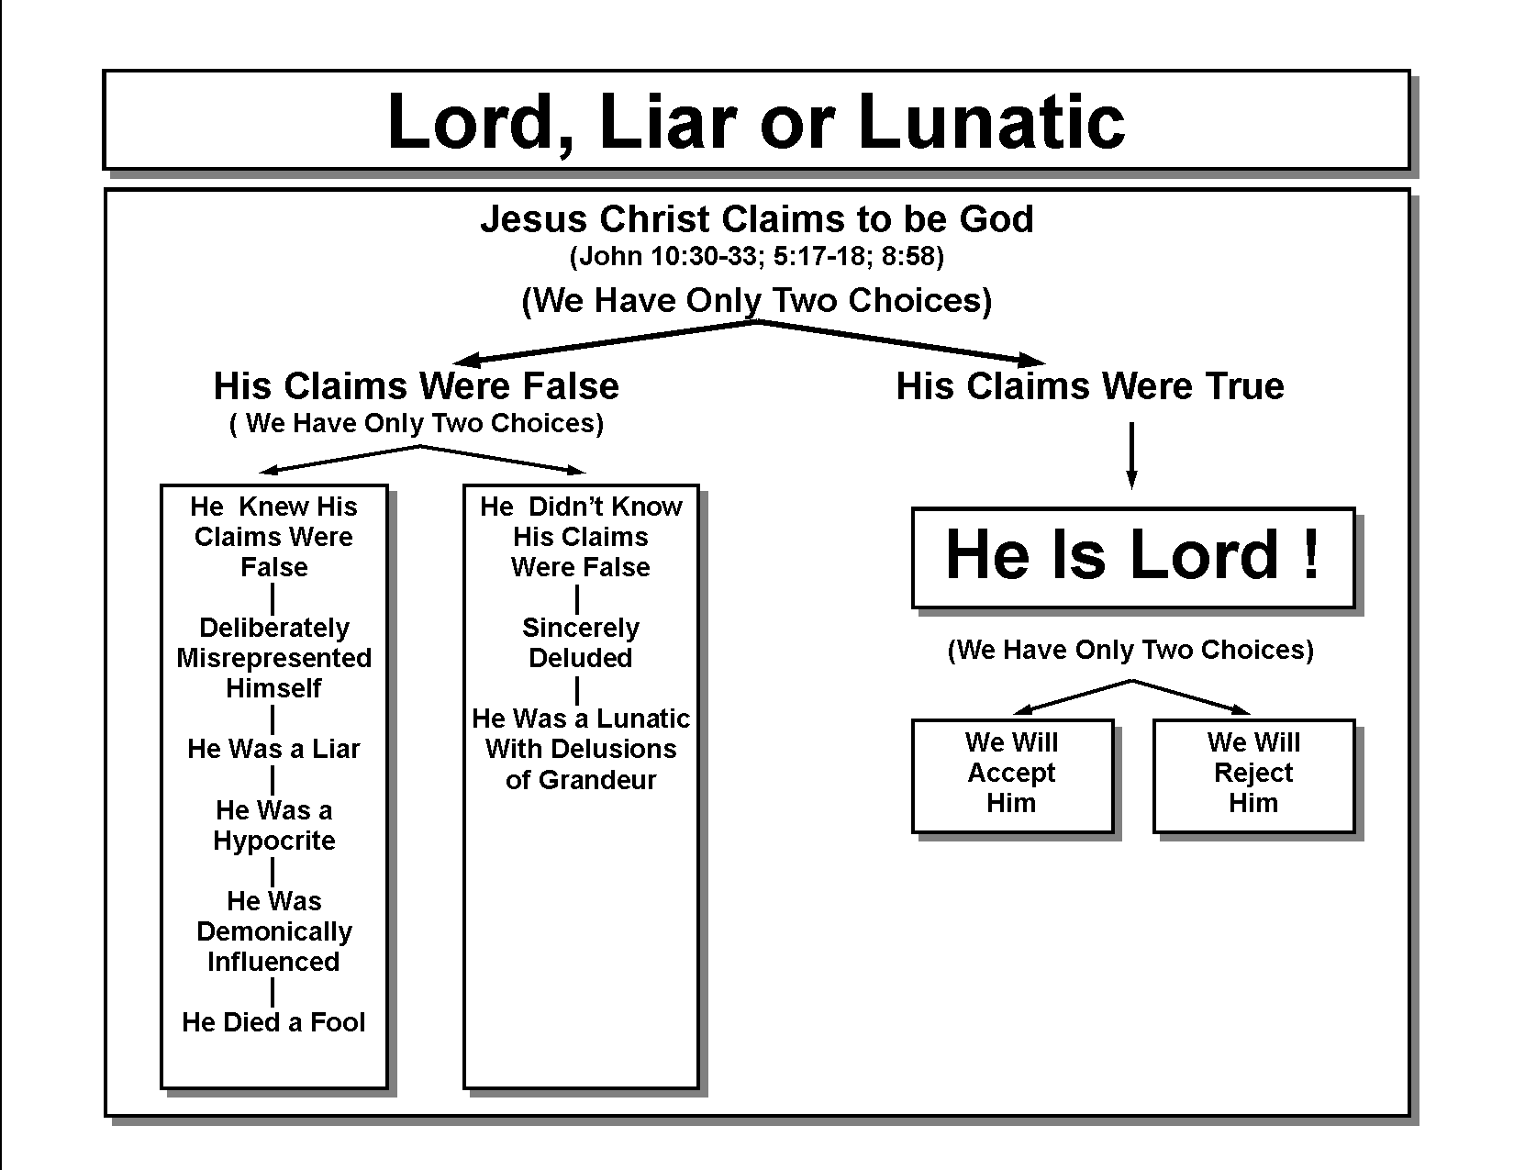
C.S. Lewis’ Trilemma

Slide 5
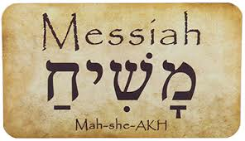
“You are the Christ.” = Messiah = the Anointed One
  This term was used in the OT during times of kings to mean chosen and empowered by God for a particular task. The expectations of the Jews were that the ultimate Messiah would deliver them and establish His righteous kingdom.
  Peter’s idea of the Messiah was very different from what Jesus actually was. Peter had the right word but a very flawed concept of what the Messiah would do.
Key Phrase: Jesus is “the Christ”
Notes:
Christ (Greek) = Messiah (Hebrew) = Anointed One

Slide 6
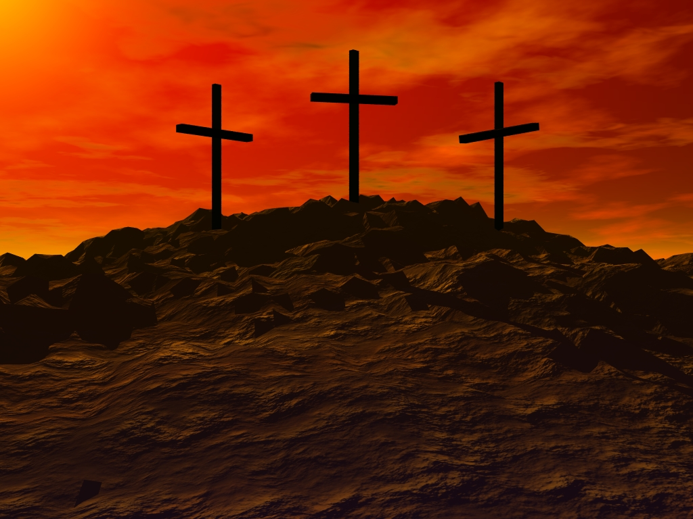
B) Jesus Predicts His Death (Mark 8:31-33)
31And He began to teach them that the Son of Man must suffer many things and be rejected by the elders and the chief priests and the scribes, and be killed, and after three days rise again. 32 And He was stating the matter plainly. And Peter took Him aside and began to rebuke Him. 33 But turning around and seeing His disciples, He rebuked Peter and said, “Get behind Me, Satan; for you are not setting your mind on God’s interests, but man’s.”

Slide 7
First time Jesus predicted His own death. He began to teach that the Son of Man must suffer many things and be rejected by the Jewish authorities. Above all that He must be killed and after three days rise again.
Jesus saw Himself as the fulfillment of Isaiah’s prophecy of a servant who would suffer on behalf of His people (Isaiah 53).
Again the Jews had a very different idea of what the Messiah would be like. In their minds the Messiah would be a victorious king and not a suffering servant. In contrast to speaking in parables, Jesus spoke very plainly about His death to a point that Peter took Him aside and began to rebuke Him.
Notes:
*Jesus began to walk towards Jerusalem.
*Significant because there were less miracles, more conflicts.
*Began to speak more clearly and no longer in parables.
*What was the Jew’s idea of what a Messiah would be like?
While the Jews expect a triumphant messiah, Isaiah 52:13—53:12 speaks of a suffering servant who:
• “Shall be exalted and lifted up” (52:13).
• “Was despised and rejected by men; a man of suffering, and acquainted with disease” (53:3)—who “was pierced for our transgressions… (and) crushed for our iniquities” (53:5).
• “Was cut off out of the land of the living and stricken for the disobedience of my people. They made his grave with the wicked” (53:8-9). (See also Psalm 22, Psalm 69, and Zechariah 9-14).

Slide 8
From a human perspective, perhaps the disciples were expecting certain benefits for following Jesus. They left their jobs and families and it was natural to think that there would be a reward. Some of them wanted to be the greatest in the kingdom. Perhaps they were thinking that kingdom of Jesus would be similar to the kingdoms of the world, where the king’s closest friends would receive the best benefits.
Instead Jesus rebuked Peter harshly. Peter was thinking about the things that ordinary human beings think about such as freedom from oppression, safety, security, money, and reward for the risk and the work. However God has something a lot more important than that. Overcoming an enemy that must be conquered by suffering and death and not just replacing Roman rulers with Jewish ones.
Key Phrase: Son of Man must suffer and die!!!
Notes:
*Why did Jesus speak so harshly to Peter?

Slide 9
C) Take Up the Cross (Mark 8:34-38)
34And He summoned the crowd with His disciples, and said to them, “If anyone wishes to come after Me, he must deny himself, and take up his cross and follow Me. 35 For whoever wishes to save his life will lose it, but whoever loses his life for My sake and the gospel’s will save it. 36 For what does it profit a man to gain the whole world, and forfeit his soul? 37 For what will a man give in exchange for his soul? 38 For whoever is ashamed of Me and My words in this adulterous and sinful generation, the Son of Man will also be ashamed of him when He comes in the glory of His Father with the holy angels.”

Slide 10
V. 34 What does it mean to deny self and to carry the cross? This does not mean we are to deny ourselves the ways of this world but rather the perceived right to direct our own lives (ex. Buddhist). We are to submit to God’s will for our lives and to give up ownership of ourselves. This will bring opposition to our lives as it did to Jesus (ex. Parents, choices that we have to make, etc.).
What is the paradox in v. 35?
Notes:
*What does it mean to deny self? Say no to yourself and yes to God.
*What does the image of carry the cross mean? Not wearing the symbol of a cross.
*Buddhist deny themselves of this world, isolate themselves in monastery and have less and less contact with people in order to achieve nirvana.
*Christians are to enjoy the creation, this world that God has given us.
*Examples of my parent’s reaction when I first became a Christian. Over time after they witness our lives, they began to soften their stance.
*v. 35? Whoever that has control of his life actually forfeits the authentic life that only Jesus can give.
The challenge to lose our lives for Jesus’ sake conflicts with modern values. Preservation of life is a major industry. Modern medicine, proper diet, and exercise extend our lives. Cosmetics and plastic surgeons preserve our appearance. Funeral directors continue the work even after we die. We find it difficult to hear Jesus’ call to lose our lives for his sake.

Slide 11
V. 36-37 “What good is it, for someone to gain the whole world, yet forfeit their soul?” Our soul is worth much more than the “whole world.” Jesus is pointing out the foolishness of obtaining what the world offers by trading away the most valuable possession that we have, our soul. Whether it’s military conquest or financial gain you cannot take all of that with you when you pass away. What is needed is a Messiah who conquers death itself and reemerges victorious.
Path to following Jesus is not an easy path. Must be willing to put aside fame and fortune and be willing to follow Jesus even to death. This was the case for many of the disciples including Peter who was said to have been crucified upside down on a cross in Rome.
Key Phrase: “Not only must Jesus suffer but “you must as well” if you choose to follow Him”
Notes:
Would Peter do this for a liar? For a lunatic? For Christ the Lord?

Slide 12
Discussion Questions
Do you think C.S. Lewis’ Trilemma is logical? Is there a 4th option?
Why did Jesus have to die on the cross?
What are some of the costs that you had to count in order to follow Jesus?

