Slide 1
Our Hunger for God’s Lessons
Mark 6:30-44
Paul J. Bucknell

Slide 2





The Gospel of Mark
Jerusalem
16:9-20
16:8
Son of Man 11/13 from 8:31
Jesus, the Son of Man – Human
Slow, framed in one place, must understand what happens; history becomes truth.
(1) John the ‘Preparer’
(2) Christ the ‘Server’
(3) Disciples the ‘Followers’
What is your response to Jesus?
“Following Him on the road?”
(10:52)
10:46
BLIND
10:46-52
“Thou art the Christ!” (8:29)
10:45
“For even the Son of Man did not come to be served, but to serve, and to give His life a ransom for many.” (10:45)
On road to Jerusalem
Center section
8:27
How did people respond to Jesus?
BLIND
8:22-26
Galilee
8:26
“Do you not yet understand?”
(8:21)
Jesus, the Son of God – Divine
Action-packed scenes (“immediately”); demon dispersing; healing; miracles, action, powerful messages.
What does it mean that Jesus can do such great things?
Son of God 3/3 Claim -devil, centurion 1:1; 3:11; 15:39
1:1

Slide 3
A) The Test of Circumstances: Rest and Resume (Mark 6:30-34)
30 And the apostles gathered together with Jesus; and they reported to Him all that they had done and taught. 31 And He said to them, “Come away by yourselves to a lonely place and rest a while.” (For there were many people coming and going, and they did not even have time to eat.) 32 And they went away in the boat to a lonely place by themselves. 33 And the people saw them going, and many recognized them, and they ran there together on foot from all the cities, and got there ahead of them. 34 And when He went ashore, He saw a great multitude, and He felt compassion for them because they were like sheep without a shepherd; and He began to teach them many things. (Mark 6:30-34; NASB)
“Apostles” (30) only used here in Mark. Jesus invests His authority in them and then counts on them. God always equips us for the work for our service to which He calls us.
“They reported” (30) shows the Lord’s expectations, making us accountable. How are we doing in understanding and carrying out what God has for us?

Slide 4
A) The Test of Circumstances: Rest and Resume (Mark 6:30-34)
31 And He said to them, “Come away by yourselves to a lonely place and rest a while.” (For there were many people coming and going, and they did not even have time to eat.) 32 And they went away in the boat to a lonely place by themselves. 33 And the people saw them going, and many recognized them, and they ran there together on foot from all the cities, and got there ahead of them. 34 And when He went ashore, He saw a great multitude, and He felt compassion for them because they were like sheep without a shepherd; and He began to teach them many things. (Mark 6:31-34)
“Rest a while” (31) depicts how we can get so busy with life and ministry that we must purpose to spend time with Jesus. Miraculous incidents become cataracts of the soul if time isn’t spent with God.
The crowds “got there ahead of them” (33) points out that at times, although needing rest, we really need great trust in God to see and care for the compelling needs of those around us.
Examples: A spouse’s harsh remarks? A child’s bad day?
“He went ashore” (34) shows Jesus’ commitment and willingness to place the needs of others over His own, while the phrase “He felt compassion” shows us the mindset that is needed to rightly minister to others without being ensnared in the devil’s temptation to us glory and power to poison our ministries.
“He began to teach them many things” (34) even when it was already quite late, displaying the great hunger of God’s people. Their rapt attention to the Word of God overcame their physical appetites.

Slide 5
Two Life Tests
Exhausted,
Needs rest
Belief & compassion
Trust
Pride
Burnout
Rest
Great ministry
God-given rest
God-given challenges
self-glory
compassion
At times in life we see our surrounding needs drive us beyond ourselves. Challenges reveal what is in us and what God can do.
We can be tested at any moment, even at the greatest points of self-sacrifice.
unbelief & irritation
Belief & compassion

Slide 6


Understanding Life’s Drives
NORMAL
Physical Drives
Spiritual Drives
Physical desires can become so powerful and strong that they can drive out any real and genuine spiritual sensitivities that we have, allowing us to be mastered by our flesh, leaving us like
headless King Saul,
taunted by the enemy, “fastened his body to the wall of Beth-shan”.
(1 Sam 31:8-10).
Spiritual Drives
Physical Drives
God made us so that our spiritual sensitivities would guide us even during times of temptation. (Gen 3:5-7)
God made us to succeed. The problem is that we give up and succumb to our physical drives, allowing the flesh to give into our desires which are not under God’s bridle. They are evil desires.

Slide 7
B) The Purposed Test by Jesus: Trust (Mark 6:35-44)
“35 And when it was already quite late, His disciples came up to Him and began saying, “The place is desolate and it is already quite late; 36 send them away so that they may go into the surrounding countryside and villages and buy themselves something to eat.” 37 But He answered and said to them, “You give them something to eat!” And they said to Him, “Shall we go and spend two hundred denarii on bread and give them something to eat?” 38 And He said to them, “How many loaves do you have? Go look!” And when they found out, they said, “Five and two fish.” 39 And He commanded them all to recline by groups on the green grass. 40 And they reclined in companies of hundreds and of fifties.
41 And He took the five loaves and the two fish, and looking up toward heaven, He blessed the food and broke the loaves and He kept giving them to the disciples to set before them; and He divided up the two fish among them all. 42 And they all ate and were satisfied. 43 And they picked up twelve full baskets of the broken pieces, and also of the fish. 44 And there were five thousand men who ate the loaves.”” (Mark 6:35-44)

Slide 8
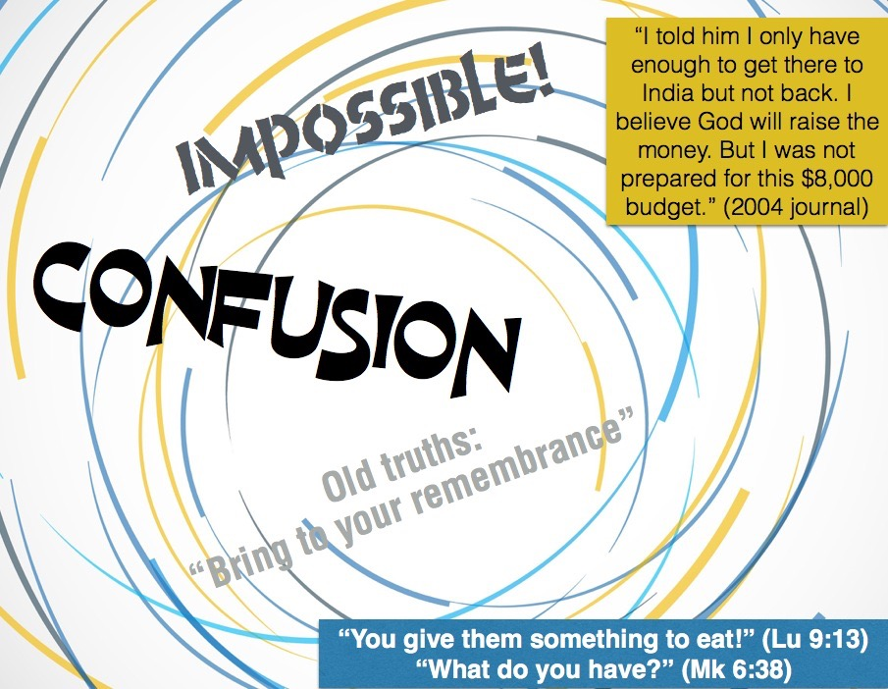
B) The Purposed Test by Jesus: Trust (Mark 6:35-44)
“35 And when it was already quite late, His disciples came up to Him and began saying, “The place is desolate and it is already quite late; 36 send them away so that they may go into the surrounding countryside and villages and buy themselves something to eat.” 37 But He answered and said to them, “You give them something to eat!” And they said to Him, “Shall we go and spend two hundred denarii on bread and give them something to eat?”
“Already quite late” (35). Trying to politely take control of what could be a disastrous mess. Their suggestion wasn’t bad, but it was missing God’s greater purposes. Worry is known for failure in trusting God’s power and purposes.
“You give them something to eat!” (37) really startled them. Where would they get that great amount of money to feed everyone. One denarius is equivalent to a day of work (today’s 2/3 annual salary for that many people).
Personal testimony of worry. On my first trip to India I started to fall into worry. I remember walking back and forth in my backyard, wondering how I was going to pay for the trip and ministry to India, then….

Slide 9

B) The Purposed Test by Jesus: Trust (Mark 6:35-44)
“38 And He said to them, “How many loaves do you have? Go look!” And when they found out, they said, “Five and two fish.” 39 And He commanded them all to recline by groups on the green grass. 40 And they reclined in companies of hundreds and of fifties.” 41 And He took the five loaves and the two fish, and looking up toward heaven, He blessed the food and broke the loaves and He kept giving them to the disciples to set before them; and He divided up the two fish among them all.
“How many loaves do you have? Go look!” (38) shows us that God usually takes what we have and transforms it so that it becomes sufficient. God in His divine wisdom has placed what we need when we need it so that we can always carry out His will.
“He blessed the food and broke the loaves” are two important steps. The blessing of God on what we presently have changes what we have. While desperately running around for nutritious food, we can forget to believe God can bless our food for His greater purposes.
“He broke the loaves” (41). What do you think the disciples and people were thinking about when Jesus started breaking and distributing the loaves and fish? What was Jesus believing? Jesus knew God heard.

Slide 10
Discussion Questions
Share about a time you felt ‘burned-out’? Were you close to the Lord or not? Explain.
How did Jesus get extra strength for the demanding crowds who wanted His attention? Do you ever face such demands on you? How do you handle them? What can we learn from Jesus?
Why does worry keep us from seeing God’s miracles?

Slide 11
Our Hunger for God’s Lessons
Mark 6:30-44
Paul J. Bucknell

